Slide 1
Lesson Plan: Social Media 10 – 12 Years
Media Literacy for All

Slide 2
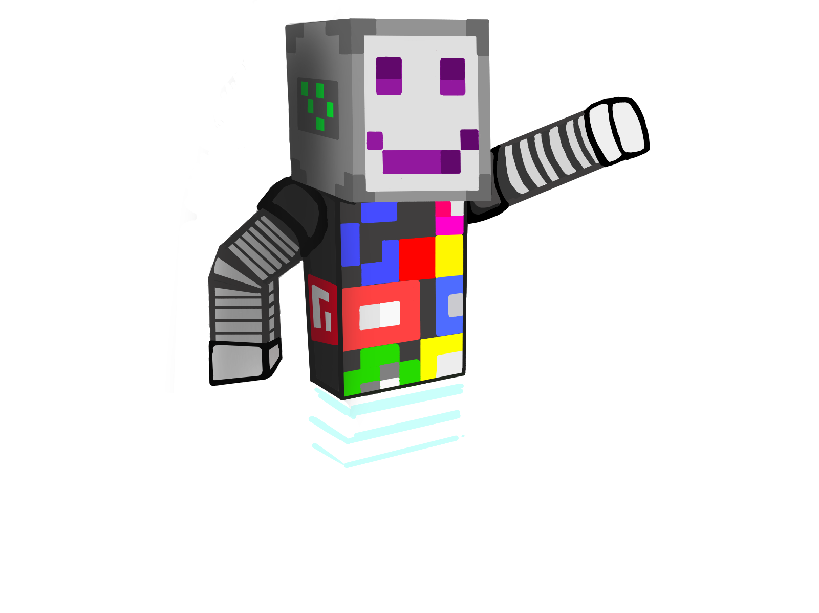
Social Media Advertising
Let’s create some posts!
Post for a party you’re organizing
Post for a charity event
Post about a toy or videogame review

Slide 3
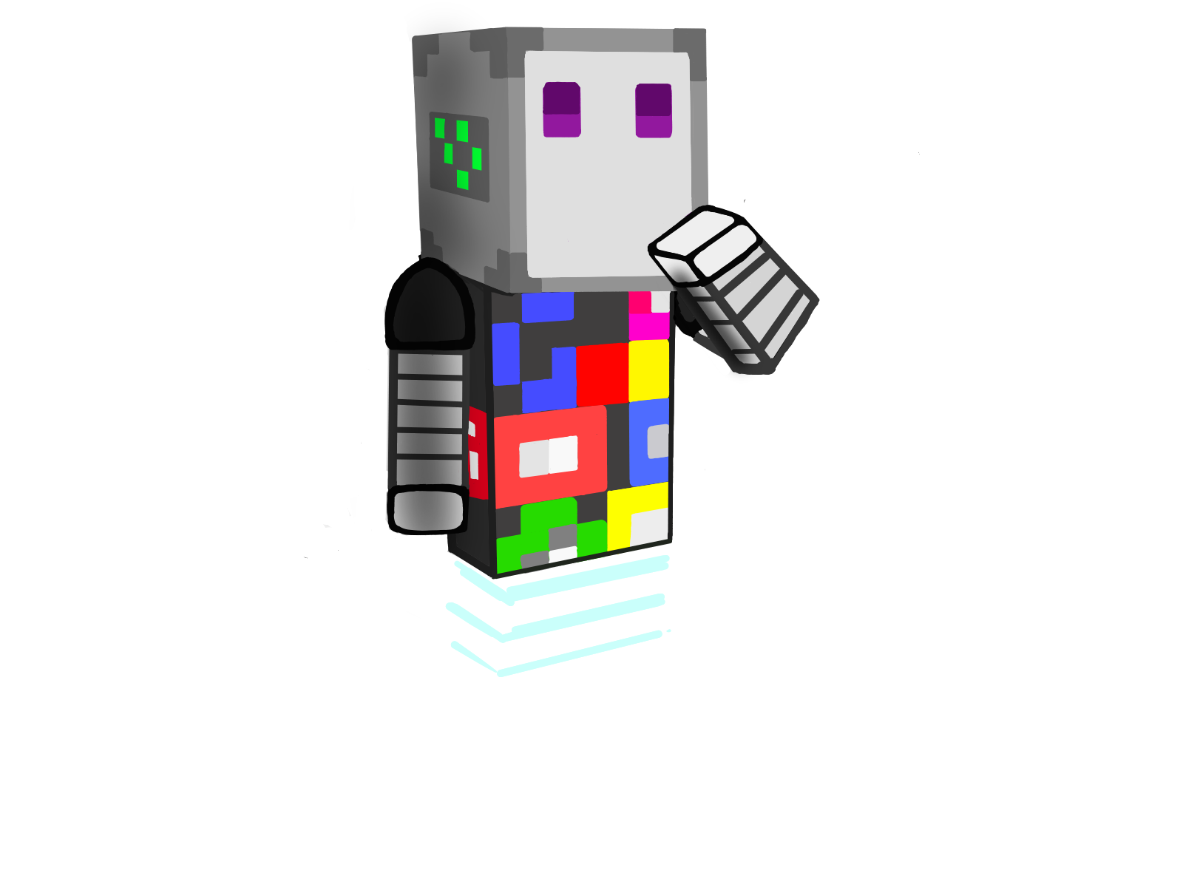
What Type of Social Media Advertising is this?
Who is the target?
🧩 Spark Curiosity and Learning with [Brand] Educational Toys! 🌟
Discover a world of fun and knowledge with our interactive toys. Ignite imagination and promote early learning. #PlayAndLearn

Slide 4
Social Media Advertising
Advertising Technique: Emotional Appeal
🧩 Spark Curiosity and Learning with [Brand] Educational Toys! 🌟
Discover a world of fun and knowledge with our interactive toys. Ignite imagination and promote early learning. #PlayAndLearn
Target: Children, and Parents looking for engaging and educational toys
for their children

Slide 5
What Type of Social Media Advertising is this?
Who is the target?
🍿 Create Unforgettable Moments with [Movie Streaming Service] Family Movie Night! 🎥
Gather the family for a cinematic adventure. Enjoy quality time and laughter together. #FamilyFun

Slide 6
Social Media Advertising
Advertising Technique: Emotional Appeal
🍿 Create Unforgettable Moments with [Movie Streaming Service] Family Movie Night! 🎥
Gather the family for a cinematic adventure. Enjoy quality time and laughter together. #FamilyFun
Target: Children, and Parents seeking family-friendly entertainment options
and quality bonding time.

Slide 7
What Type of Social Media Advertising is this?
Who is the target?
👨‍👩‍👧‍👦 Strengthen Your Parenting Skills with [Workshop Name]! 👪
Join our interactive workshop for expert guidance and support. Elevate your parenting journey. #EmpoweredParents

Slide 8
Social Media Advertising
Advertising Technique: Special Offer
👨‍👩‍👧‍👦 Strengthen Your Parenting Skills with [Workshop Name]! 👪
Join our interactive workshop for expert guidance and support. Elevate your parenting journey. #EmpoweredParents
Target: Parents seeking parenting advice and strategies to enhance their parenting skills

Slide 9
What Type of Social Media Advertising is this?
Who is the target?
☕ Start Your Day Right with [Coffee Shop] Brews! ☀️
Indulge in the rich aroma and flavor of our handcrafted coffees. Your daily dose of happiness awaits. #MorningMood

Slide 10
Social Media Advertising
Advertising Technique: Special Offer
☕ Start Your Day Right with [Coffee Shop] Brews! ☀️
Indulge in the rich aroma and flavor of our handcrafted coffees. Your daily dose of happiness awaits. #MorningMood
Target: Sports enthusiasts, young adults, teenagers seeking an energy boost

Slide 11
What’s the technique used in this example?
🌟 Brighten Someone's Day with Love and Flowers! 🌼 Share heartfelt moments with our enchanting flower bouquets. Every petal tells a story of love and care. Send a burst of happiness to your loved ones today. Experience the joy of giving and make memories that last a lifetime. Order now to spread love and smiles! #ShareHappiness #MomentsOfLove

Slide 12
What’s the technique used in this example?
Special Offer
🌟 Brighten Someone's Day with Love and Flowers! 🌼 Share heartfelt moments with our enchanting flower bouquets. Every petal tells a story of love and care. Send a burst of happiness to your loved ones today. Experience the joy of giving and make memories that last a lifetime. Order now to spread love and smiles! #ShareHappiness #MomentsOfLove

Slide 13
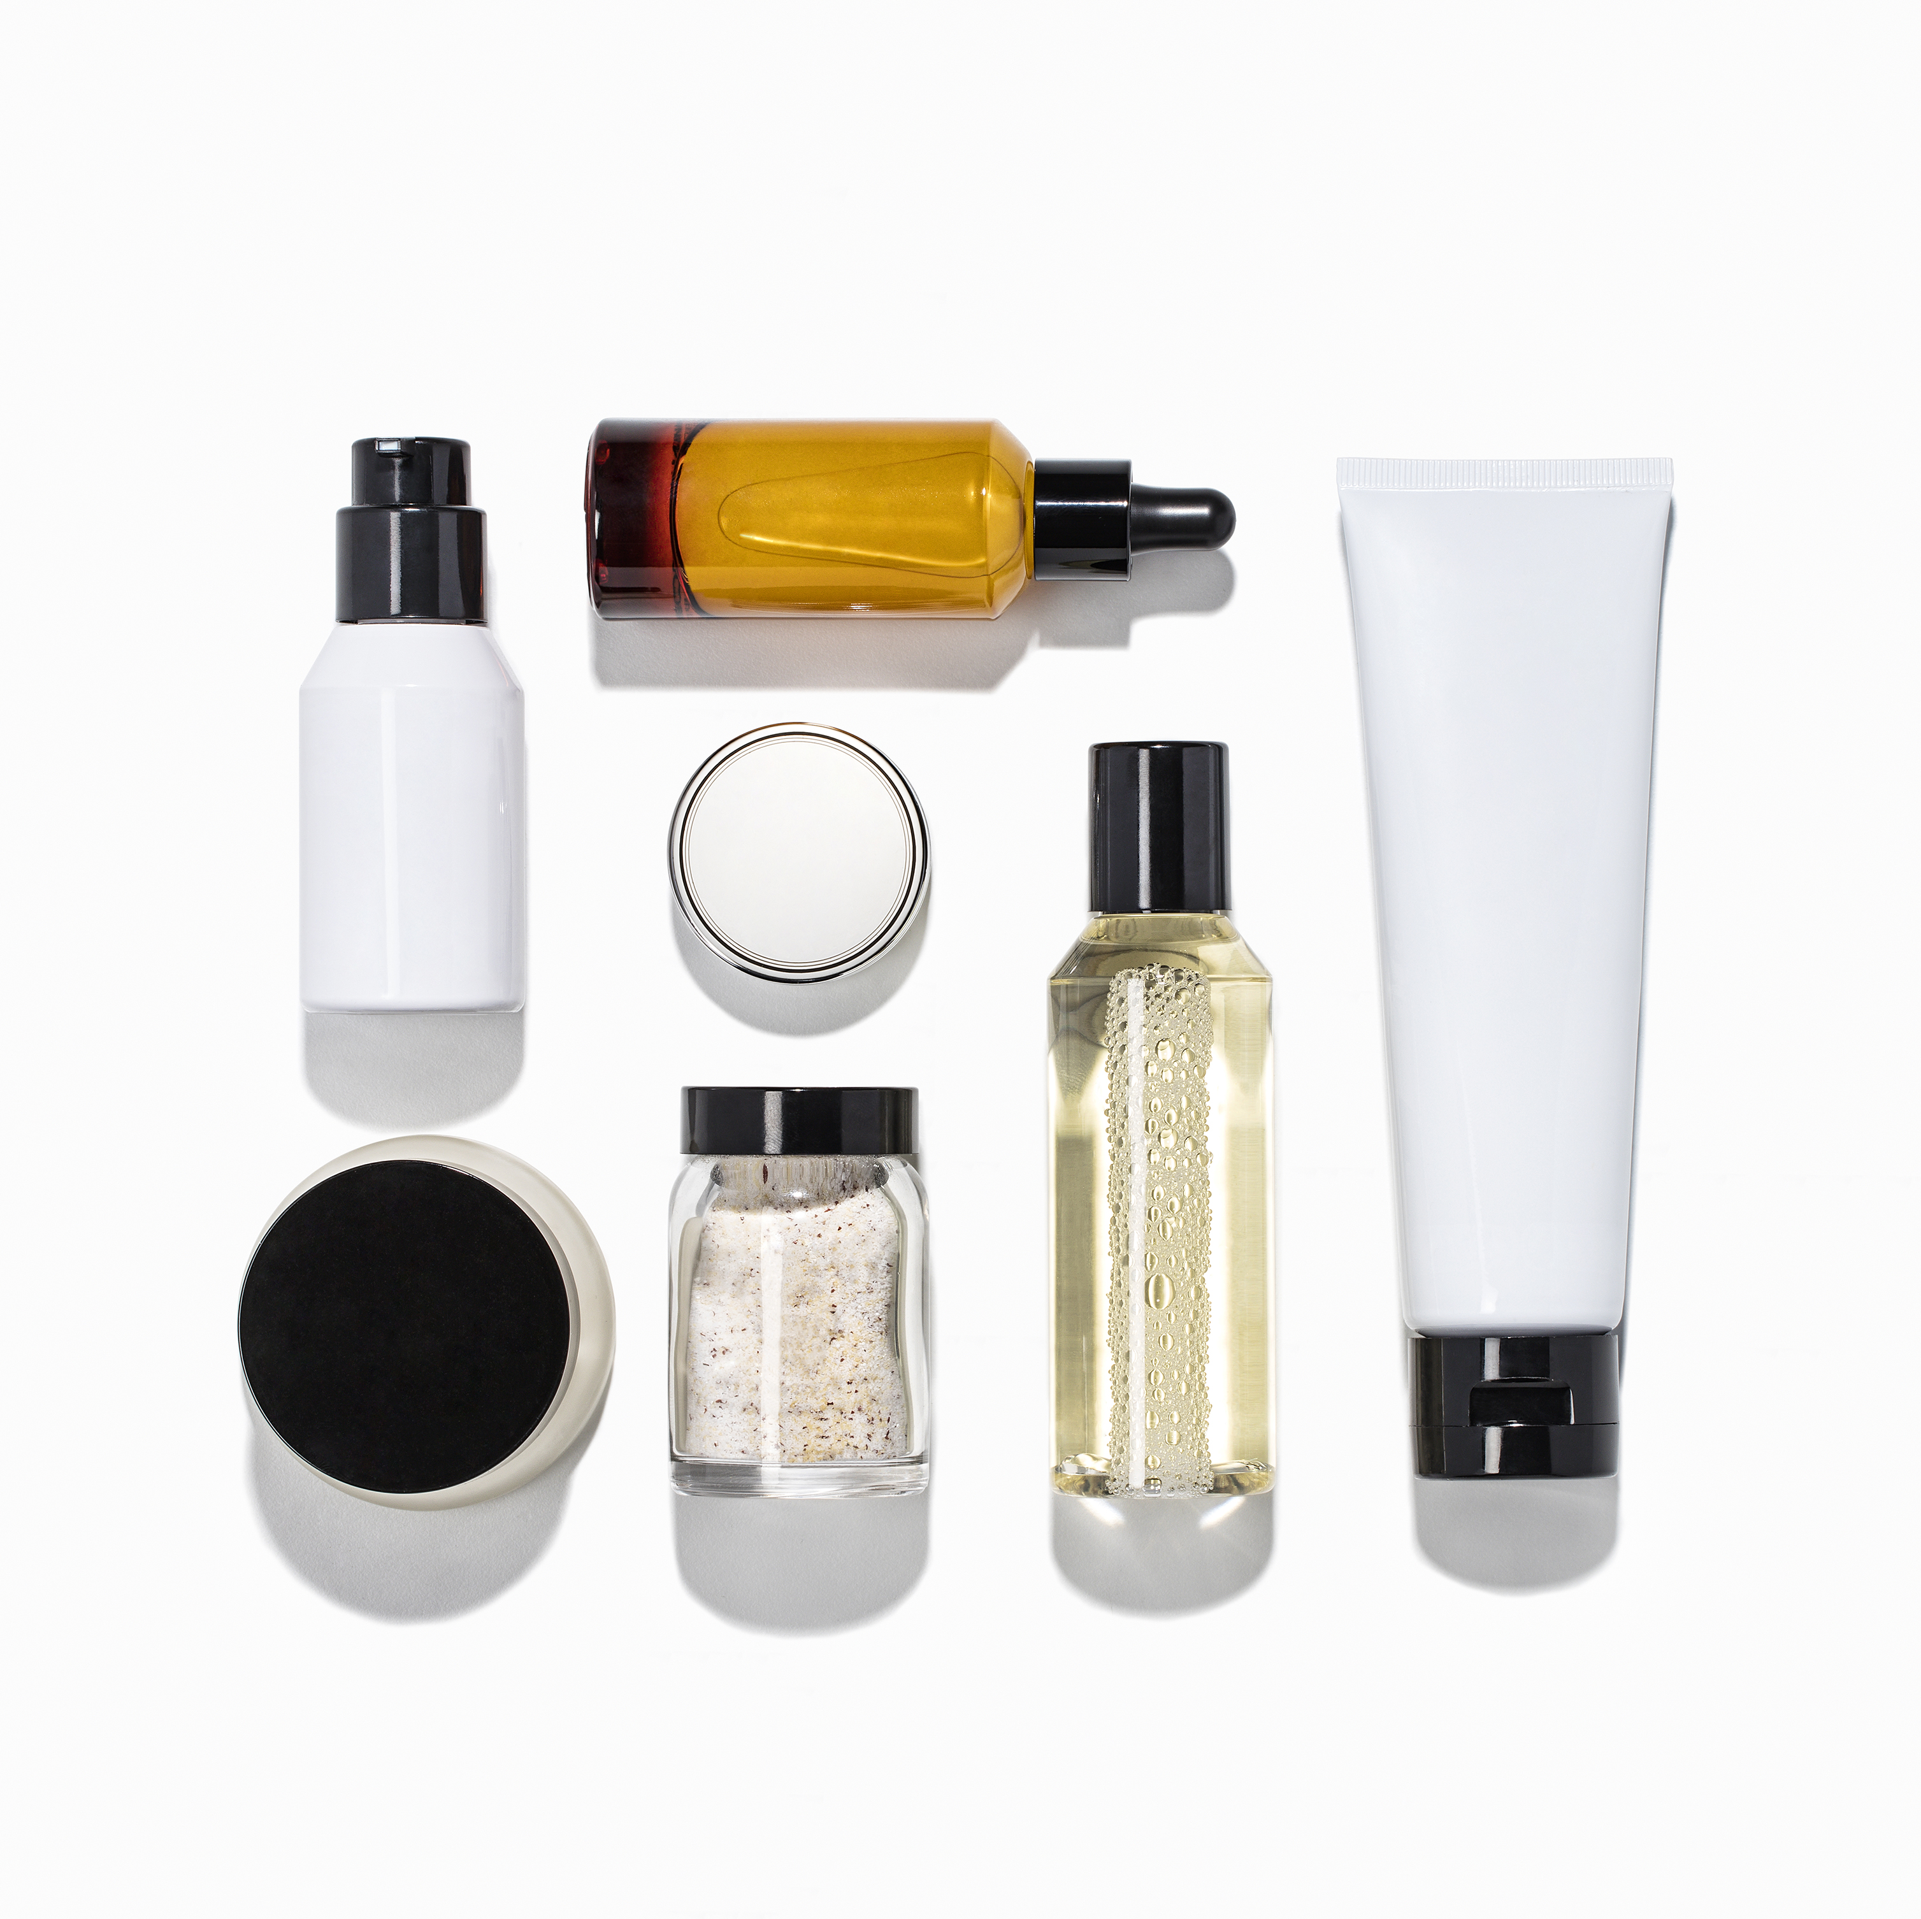
What’s the technique used in this example?
🌟 Step into Confidence with [Celebrity Name]'s Choice! 🌟 Discover the secret to radiant skin with [Skincare Brand]. Recommended by the sensational [Celebrity Name], our skincare products are your path to glowing beauty. Join the ranks of those who trust the best. Unlock your skin's potential today! #CelebrityApproved #GlowingBeauty

Slide 14
What’s the technique used in this example?
Celebrity Endorsement
🌟 Step into Confidence with [Celebrity Name]'s Choice! 🌟 Discover the secret to radiant skin with [Skincare Brand]. Recommended by the sensational [Celebrity Name], our skincare products are your path to glowing beauty. Join the ranks of those who trust the best. Unlock your skin's potential today! #CelebrityApproved #GlowingBeauty

Slide 15
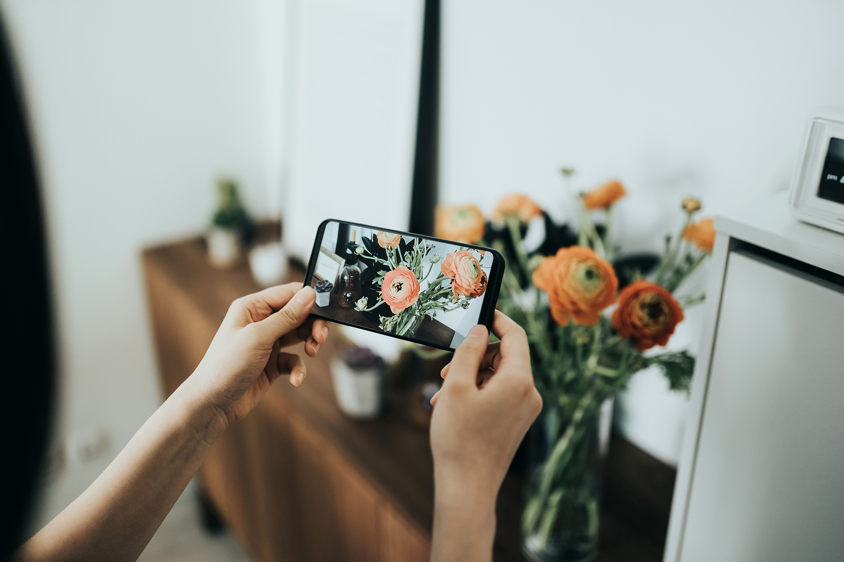
What’s the technique used in this example?
🎉 Exclusive Deal Alert: Get More, Pay Less! 🎉 Upgrade your tech game with [Gadget Store]. Unleash the power of innovation at unbeatable prices. Shop now and enjoy jaw-dropping discounts on your favourite gadgets. Limited stock available, so hurry and grab yours today! #TechSavings #UpgradeNow

Slide 16
What’s the technique used in this example?
Emotional Appeal
🎉 Exclusive Deal Alert: Get More, Pay Less! 🎉 Upgrade your tech game with [Gadget Store]. Unleash the power of innovation at unbeatable prices. Shop now and enjoy jaw-dropping discounts on your favourite gadgets. Limited stock available, so hurry and grab yours today! #TechSavings #UpgradeNow

Slide 17
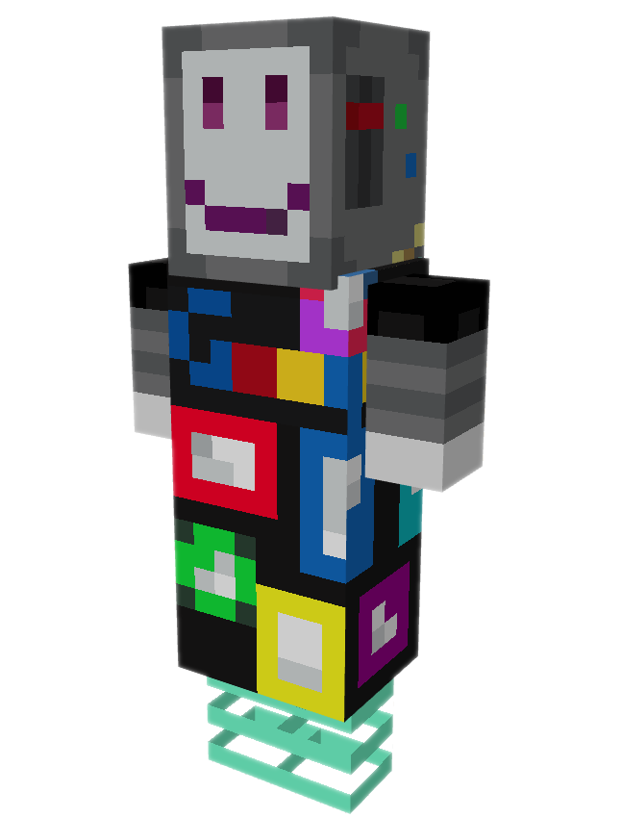
Using Social Media Safely
“A Safe and Responsible Social Media Profile”
What information should I include about myself?
What type of photos do I upload?

Slide 18
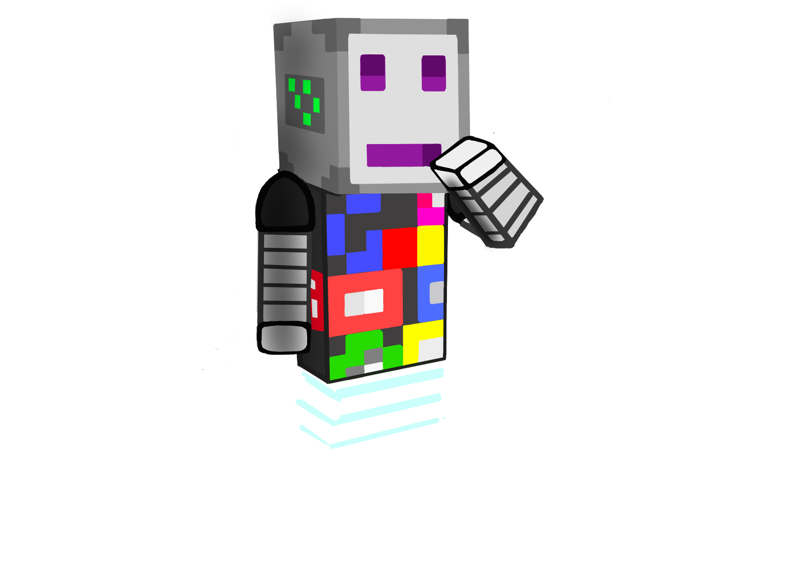
Using Social Media Safely
Protecting Personal Information
Can you tell me your mom’s maiden name? What’s your id number?
Hey I’m your uncle’s friend. Can you tell me your password?
Accompanying lesson plan images: Clipart: https://clipart-library.com/ Microsoft 365 stock images. Please see Teachers’ Toolkit for complete listings.

