Slide 1
Lesson plan – Fake News
10-12 years
Media Literacy for All

Slide 2
What is fake news?
Fake News: Made-up stories or information that may look like real news but is not true.
Fake news is created to trick people into believing things that are not real.

Slide 3
What is fake news?
Misinformation: Wrong or false information that is shared by mistake.
Sometimes, people don't check the facts before sharing something, and it can lead to misinformation.

Slide 4
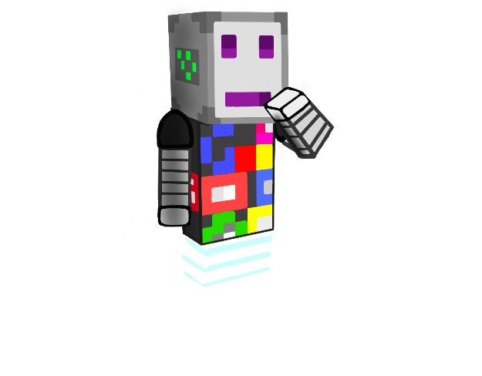
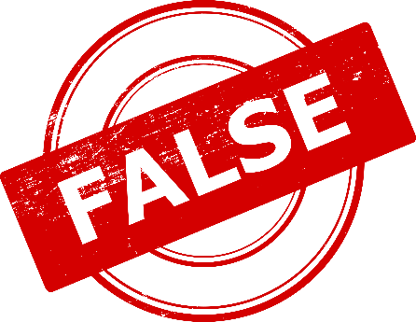
What is fake news?
Disinformation: False information deliberately spread to deceive people or to cause confusion.
It's like telling a lie on purpose to trick others.

Slide 5
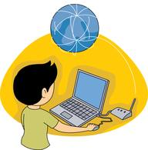
What is fake news?
Fact-Check: To verify if something is true or false by looking at different sources and evidence.
Fact-checking helps us know if what we hear or read is real or fake.

Slide 6
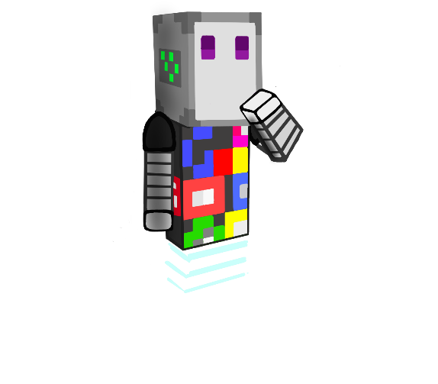
What is fake news?
Critical Thinking: Thinking carefully and asking questions before believing something.
It helps us decide if information is reliable or not.
Why?
Who?
Where?
What?

Slide 7
Vocabulary
What does each term mean?
Hoax
Media Literacy
Source
Internet Safety
Clickbait

Slide 8
What is fake news?
Let’s play Fact or Fiction Telephone!

Slide 9
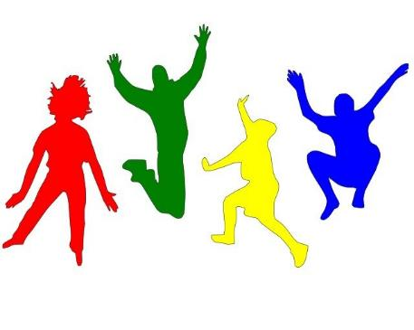
What is fake news?
How did the facts change from the original one as they went around the circle?

Slide 10
Reality or imagination?
There is a saying that a picture speaks more than a thousand words, but those thousand words can sometimes deceive us!

Slide 11
Reality or imagination?
Take a look at the following photographs.
Do you think they are “real”?

Slide 12
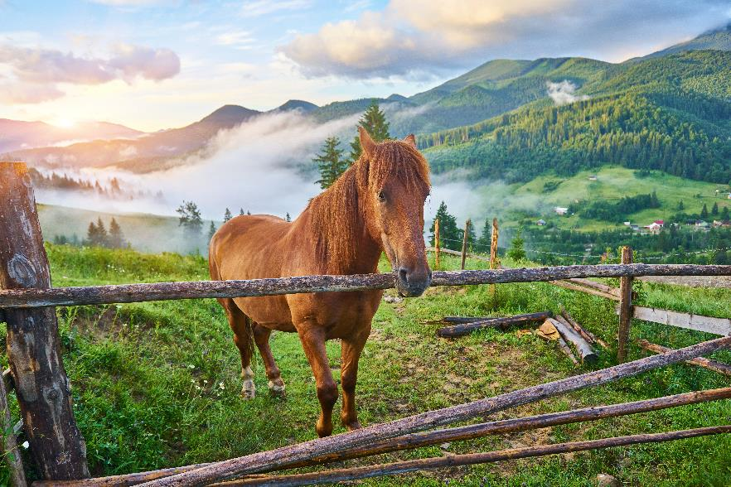
Reality or imagination?

Slide 13
Reality or imagination?

Slide 14
Reality or imagination?

Slide 15
Reality or imagination?

Slide 16
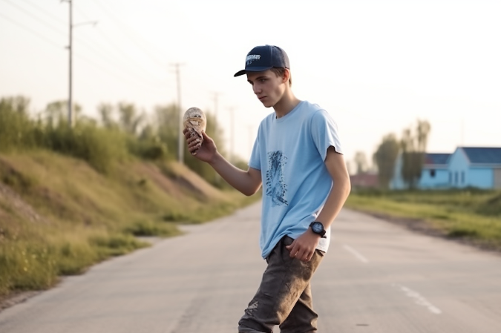
Reality or imagination?

Slide 17
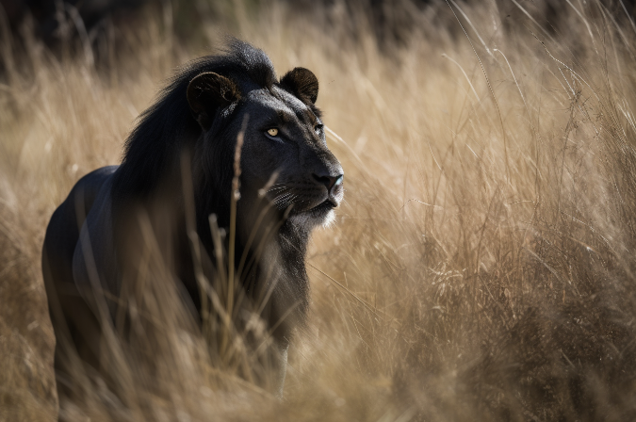
Reality or imagination?

Slide 18
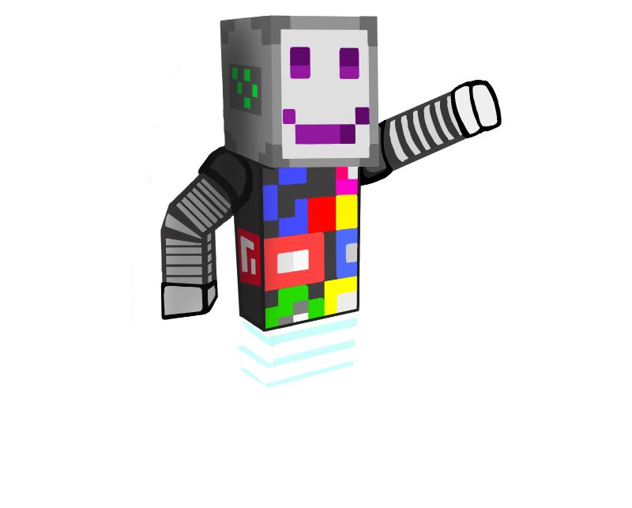
What is fake news?
Not all media message want to deceive us
BUT…
All media messages compete for our attention, therefore sometimes people create interesting messages that are not necessarily true.
We should think twice before we believe in something and share it!

Slide 19
Fact or Opinion?
Do you know what facts are?
How would you define them?

Slide 20
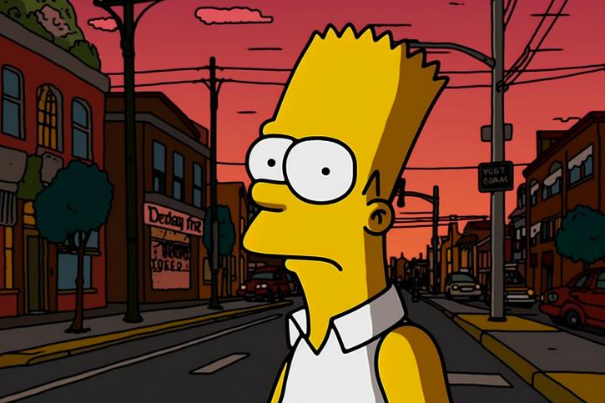
Fact or Opinion?
Bart Simpson is Jersey's worst student?!

Slide 21
Fact or Opinion?
The Simpsons predicted the appearance of a three-eyed fish near a nuclear power plant.

Slide 22
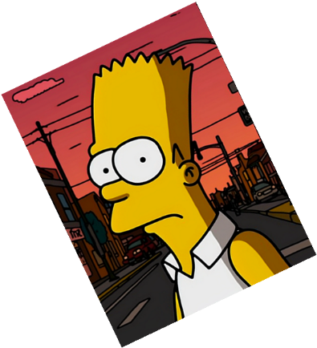
Fact or Opinion?
The Simpsons predicted the US citizen wiretapping scandal.

Slide 23
Fact or Opinion?
The Simpsons is a cartoon with the most interesting twists and turns in every episode!

Slide 24
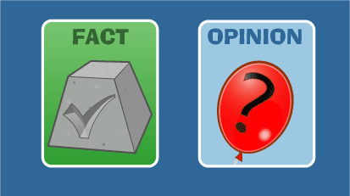
Fact or Opinion?
Did you find the truth behind the statements?
Were all the claims verifiable?

Slide 25
Debunking fake news
Who created/published that media message?
What is the purpose of the message?
Are there actual facts, or someone's personal attitude or opinion?
Who is this media message intended for?

Slide 26
Debunking fake news
Act like Sherlock Holmes!
Which of the following are True?

Slide 27
Debunking fake news
"On June 31, 2007, the last purple crocodile died in Uganda. Uncontrolled hunting led to the extinction of this exotic species. Because the price of purple crocodile skin in the fashion industry reached up to 10,000 dollars per square meter"

Slide 28
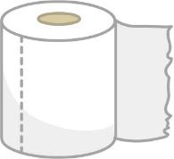
Debunking fake news
In 2013, Dalibor J. from Serbia (near Paracin) broke the Guinness record for unrolling a roll of toilet paper with one hand. He unrolled a roll of toilet paper in 9.8 seconds.

Slide 29
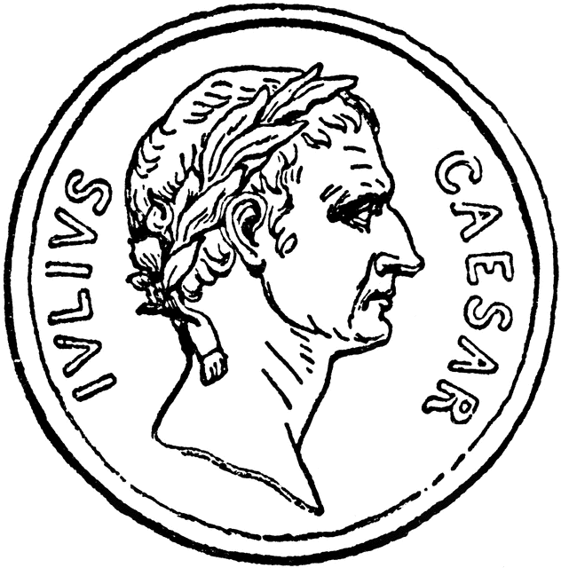
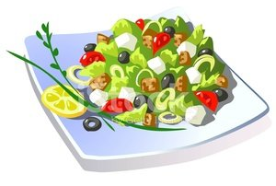
Debunking fake news
Although we all know about Caesar salad, there is information that indicates that Caesar liked potato soup the most. Which he prepared for himself every day. In addition to potatoes, in the soup he also put some carrots, ginger, onion and pepper.

Slide 30
Debunking fake news
Did you discover the true statement?
Was it easy?

Slide 31
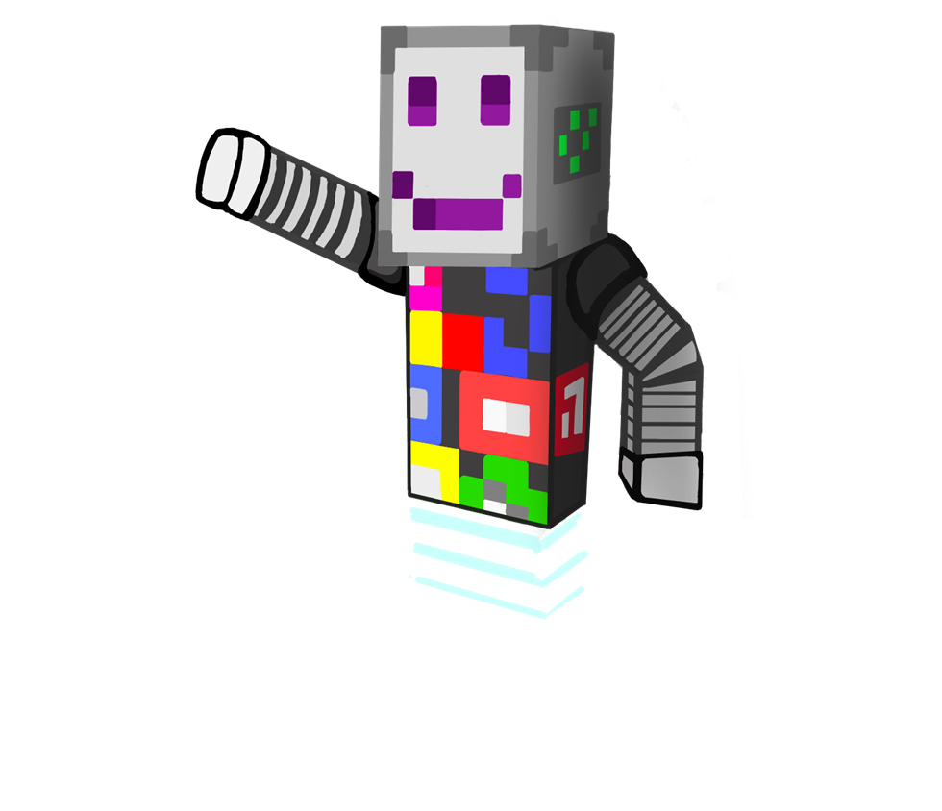
What is fake news?
Untrustworthy information is very common in media because nowadays almost everyone can create their own media messages.
Remeber how to spot the difference between fakes and facts!
Clipart: https://clipart-library.com/

