Slide 1
Lesson plan – Advertising Literacy
10-12 years
Media Literacy for All

Slide 2
Where is Advertising?
Advertising is any communication, usually paid-for, specifically intended to inform and/or influence one or more people. Advertising is a way to tell people about your product, your service or your idea

Slide 3
Where is Advertising?
Companies who make clothes, toys and sports kits, pay to have their message advertised
Companies who make food products pay to have their message advertised. Those who sell high sugar or high fat foods spend lots of money advertising their products

Slide 4
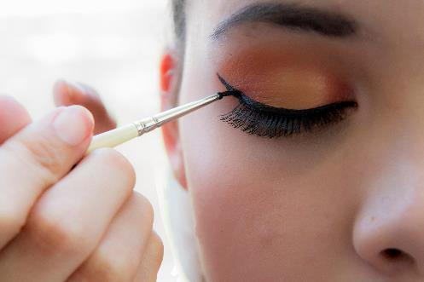
Where is Advertising?
Make up companies spend lots of money advertising their beauty products
Sports companies pay to advertise their next match, or their latest kit, or their newest sport star

Slide 5
Where is Advertising?
Common places we see advertising messages
sName some places where might you see advertising mesages placed

Slide 6
Where is Advertising?
TV programmes
YouTube
Instagram, TikTok,
Sports stadiums
Sports stars
Pop stars
Music videos
Movies, Supermarkets, Cinemas

Slide 7
Where is Advertising?
Common places we see advertising messages
TV programmes
Name some things you might you see brands placed on
Instagram, TikTok and other social media,
Apps

Slide 8
Where is Advertising?
Clothes
Shoes
Schoolbags
Lunchboxes
Food items
Cars
Technology
Sports equipment
.

Slide 9
Where is Advertising?
Can you name any unusual places you have seen advertisements?

Slide 10
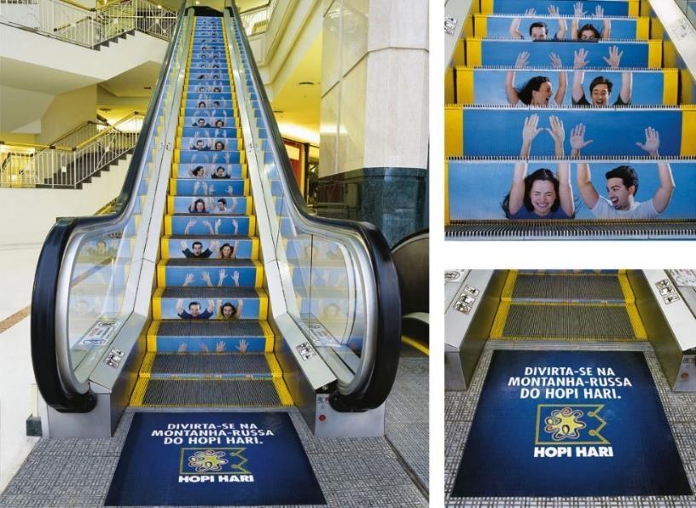
Unusual places we might see Advertising
.

Slide 11
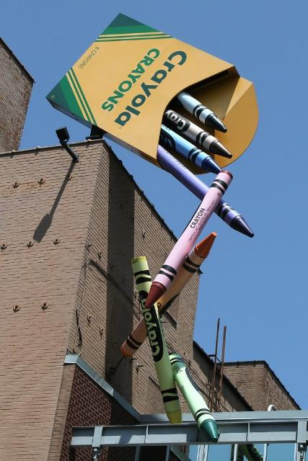
Unusual places we might see Advertising
.

Slide 12
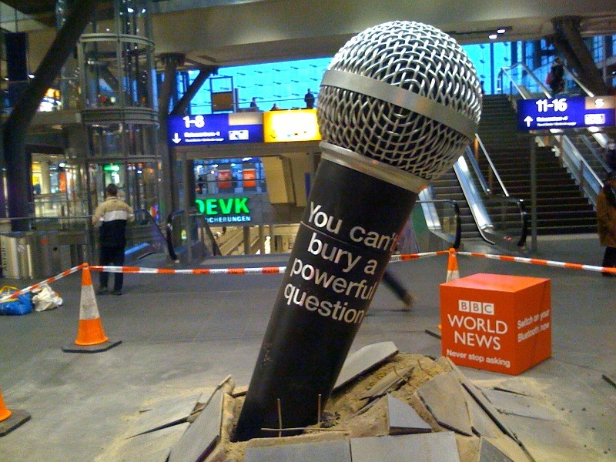
Unusual places we might see Advertising
.

Slide 13
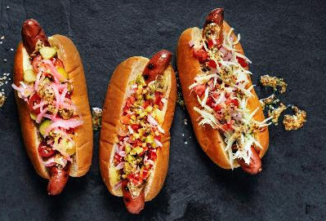
Where is Advertising?
The are rules about what can and cannot be advertised to children. Unhealthy food products (such as high fat, high sugar or high salt foods) have restrictions, or rules about where they can be advertised.
In Europe, there are rules that try to protect children from harmful advertising. However, across the world this is not always the case. You might still see some advertising that could be harmful for children, especially online.

Slide 14
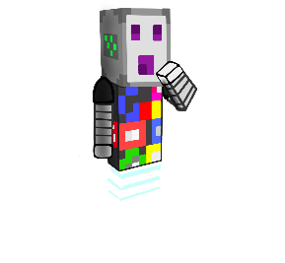
Where is Advertising?
Do you ever see advertising for products that you think might have restrictions, or should not be advertised to children?

Slide 15
What might an ad look like?
Advertisers use many different tricks to get us to believe the message they send
As we get older, we are more aware of advertising tricks
If we recognise the message as advertising, we are more likely to stop and think about the message before deciding if we believe it.

Slide 16
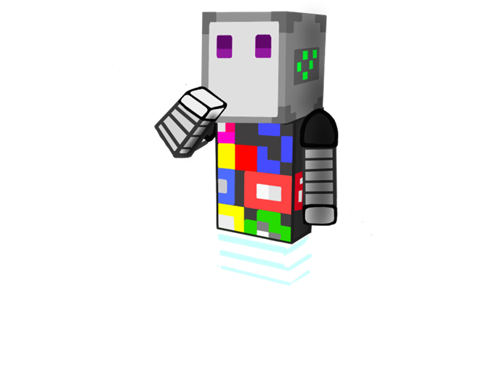
What might an ad look like?
Advertisers use different tricks to make their message more hidden so that we won’t think first
Stealth advertising or hidden advertising: the person seeing or hearing something is not aware that the message contains advertisements.

Slide 17
What might an ad look like?
Advertisers often pay an influencer who is the same age or gender as you to post messages on social media such a TikTok, Instagram and YouTube.
Influencers are paid for saying positive things about the brand, and they are also paid if they get lots of likes!

Slide 18
Where is Advertising?
Create a Presentation about your favourite influencer
Why did you choose them?
Do they ever advertise anything?
Can you always believe what they say?

Slide 19
What might an ad look like?
Product placement: a form of advertising where a company pays to place its product in a video/ movie/ cartoon/ review

Slide 20
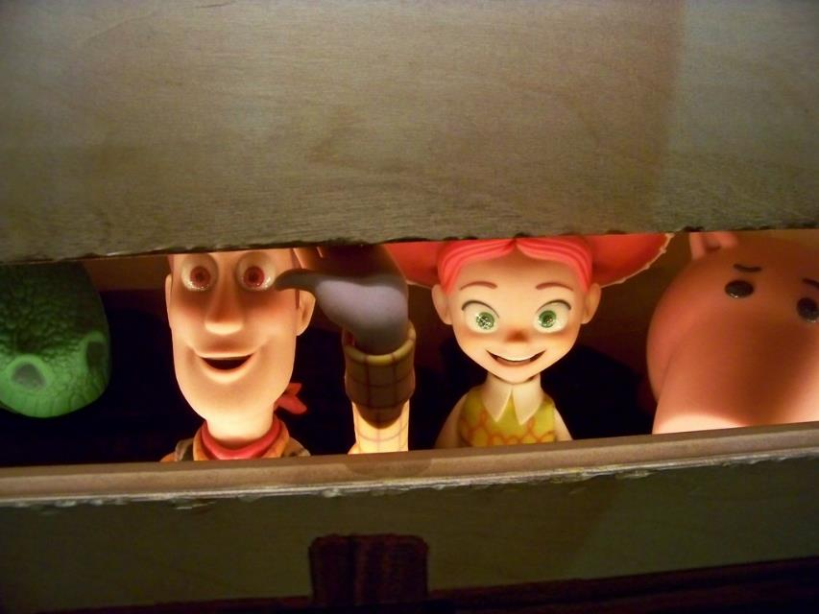
What might an ad look like?

Slide 21
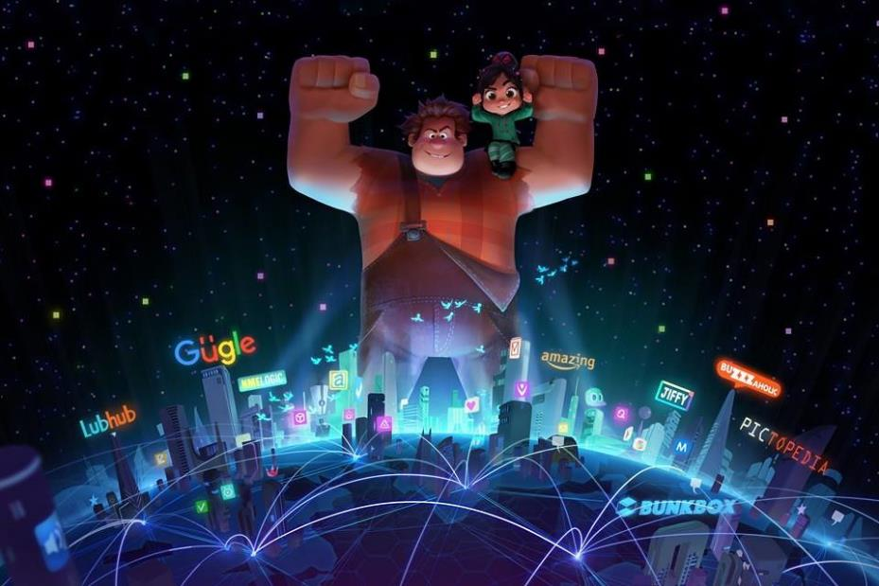
What might an ad look like?

Slide 22
What might an ad look like?
Common places we see advertising messages
Can you think of other examples of advertisements featuring in movies/ songs/ cartoons?
Instagram, TikTok and other social

Slide 23
What might an ad look like?
Common places we see advertising messages
TV programmes
What is a website cookie?
Instagram, TikTok and other social

Slide 24
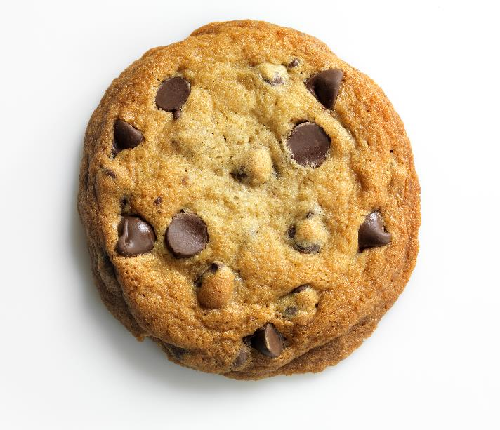
What might an ad look like?
Is it this?

Slide 25
What might an ad look like?

Slide 26
What might an ad look like?
Cookies help websites to work better by remembering information about your last visit
Website Cookies are small text files (for example your username and password) that are saved when you visit a website.
This means that some information, for example advertisements, are sent to you because of what you have watched before.

Slide 27
What might an ad look like?
Some messages are changed depending on your age, gender or location. This means different people see different ads, depending on their interests.
If a website asks you to accept cookies, it is best to always check with a parent/ guardian before clicking accept.

Slide 28
What might an ad look like?
Now we know ads we see change depending on what we like to watch
Why might this be a good thing?
Why might this not be a good thing? Instagram, TikTok and other social

Slide 29
Liking ads
Persuasion: a type of influence whereby you can cause someone to do something by giving them a good reason to do so.
Advertising tries to persuade us to feel that we 'need' to buy their product.

Slide 30
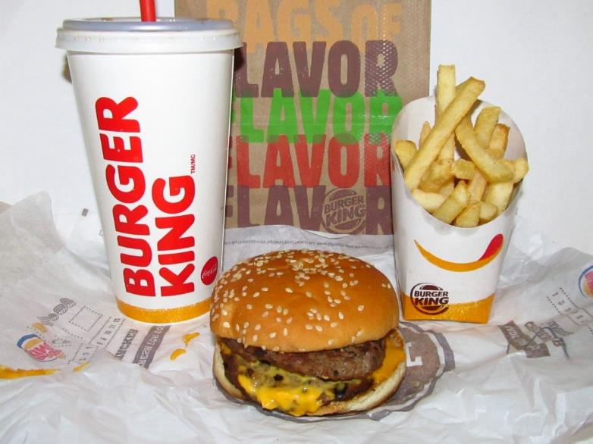
Liking ads
Do you ever feel hungry after seeing an ad for this?

Slide 31
Liking ads
Or this?
Advertisers hope this feeling will persuade you buy their product.

Slide 32
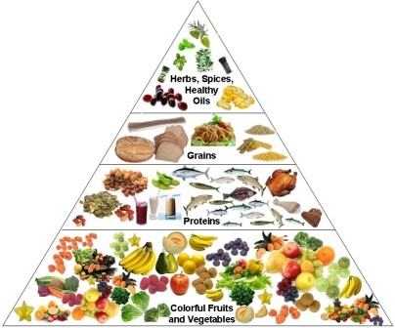
Liking ads
Some ads try to persuade you to act positively

Slide 33
Liking ads
User generated content: stories or reviews, and videos about the brand, created by a user of the brand rather than the company who owns the brand
The person sending the message, the words, the music and the humour in a message are all designed to make us like the message.
For teenagers, user generated content on social media is more persuasive advertising than traditional advertising on TV and radio

Slide 34
What to remember about advertising
Common places we see advertising messages
TV programmes
Is everything you see on Social Media real?
Instagram, TikTok and other social

Slide 35
What to remember about advertising
STOP
and
THINK
Make up your own mind if you believe the message
Accompanying lesson plan images: Clipart: https://clipart-library.com/ Microsoft 365 stock images. Please see Teachers’ Toolkit for complete listings.

