Slide 1
Lesson plan - What is media?
10-12-years
Media Literacy for All

Slide 2
What is Media?
Media is all of this!
Media content
Media equipment
Social media & Digital environments

Slide 3
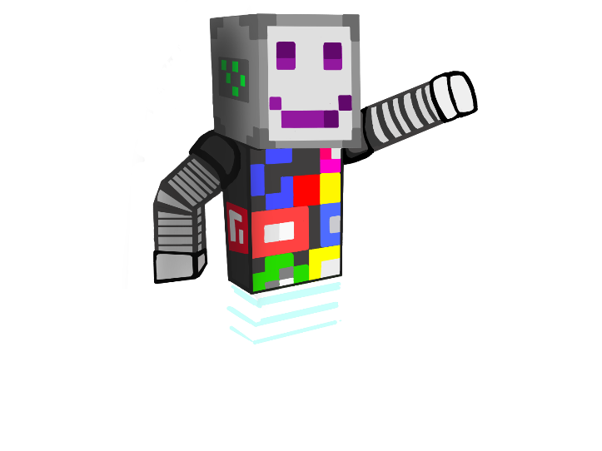
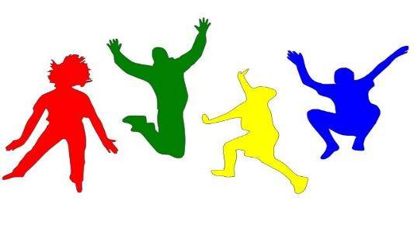
“Change Places If You…” Media style!
Arrange the chairs in the classroom in a circle. Then listen to your teacher for the rules of the game!

Slide 4
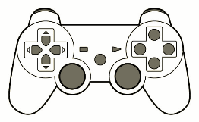
Different forms of media
Media content can be divided into different categories depending on their format and context.
Print media
Electronic media
Digital media
Social media

Slide 5
Different forms of media
Print media
Electronic media
Digital media
Social media
Make a presentation about one of these topics topics topics!
How is this form of media transmitted?
Is the format of the media traditional media, or new media?

Slide 6
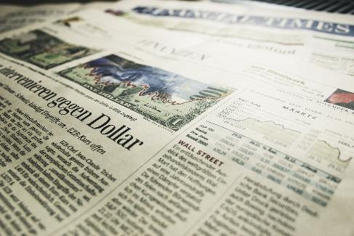
Different forms of media
Print media is communication printed on paper, such as books, magazines, and printed advertisements

Slide 7
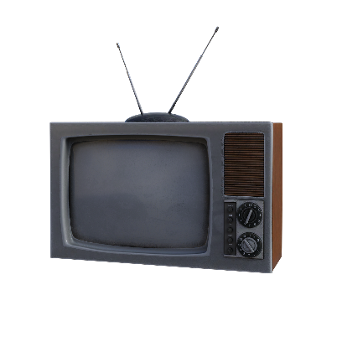
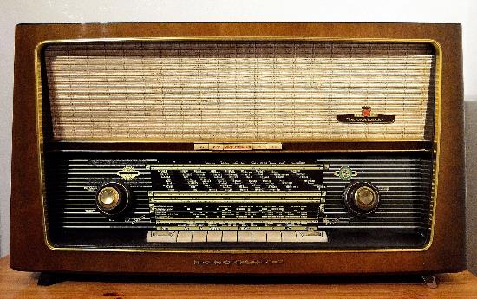
Different forms of media
Electronic media uses electromechanics to transmit messages and includes radio and television

Slide 8
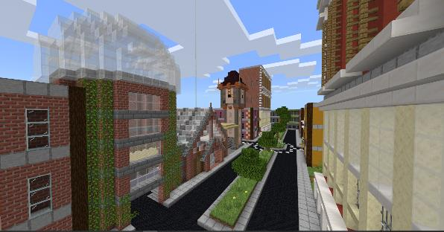
Different forms of media
Digital media is digital content encoded with a computer. This includes podcasts, computer games, movies and almost all the media content we get over the internet

Slide 9
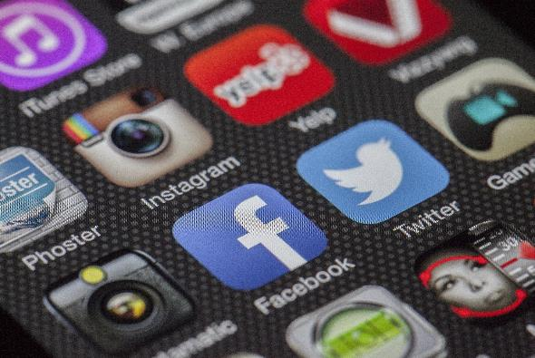
Different forms of media
Social media are digital media platforms where its users have the opportunity to produce and share content

Slide 10
How to behave in media environments
What are media environments?
Digital platforms like Facebook and other social media services, where people can interact with each other, send messages, and post pictures and videos.

Slide 11
How to behave in media environments
Why it is important to behave well in social media?
Millions of people with different backgrounds use social media every day. It is good to remember that whatever you post in social media, should never hurt another person.

Slide 12
How to behave in media environments
People have the right to protect themselves from the bad behaviour of others
Everyone has a right to ask not to be photographed or videotaped
It is polite to ask others permission before posting pictures of them to the internet

Slide 13
How to behave in media environments
Safety and being smart are the best ways to protect yourself
Never post your personal information like phone number or home address to social media
Don’t visit suspicious websites
Don’t answer to messages from strangers

Slide 14
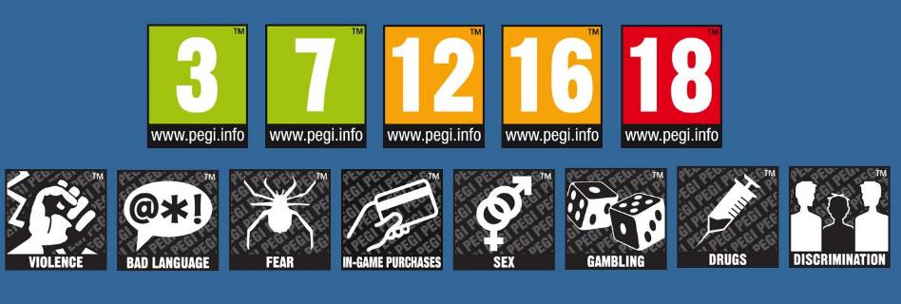
How to behave in media environments
Safety markings
Safety markings on different media products help you to recognize if that content is suitable for you.

Slide 15
How to behave in media environments
Create informative poster about how to behave on media environments!
Choose your topic:
Behaving well in media environments
Make yourself safe in media environments
What are the safety labels, and what do they mean?

Slide 16
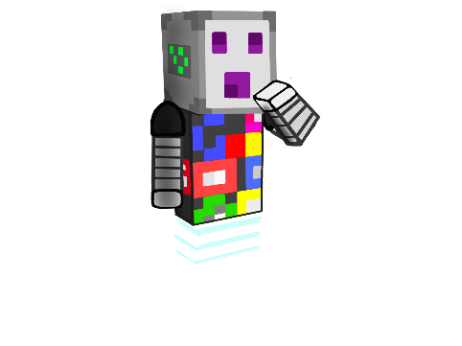
Where does the media come from?
Media is always made by someone. Can you find the author of a book or a movie?
This information should be found somewhere in the book or the cover of a dvd-box.
Clipart: https://clipart-library.com/
Notes:
Picture list:
https://pixabay.com/fi/vectors/musta-perjantai-sosiaalisen-median-post-4606225/
https://pixabay.com/fi/photos/kirja-sivuja-avoin-kirja-lukea-1868068
https://pixabay.com/fi/photos/dollari-raha-rahoittaa-us-dollar-1426420/
https://pixabay.com/fi/photos/puhelin-n%C3%A4ytt%C3%B6-sovelluksia-292994/
https://pixabay.com/fi/photos/radio-putki-radio-radiolaite-1954856
https://pixabay.com/fi/illustrations/televisio-tv-korvat-%C3%A4%C3%A4ni-kuva-3988835/,
Minding Media Minecraft World, Microsoft Minecraft Education Edition, Microsoft,
Pegi labels: https://www.saferinternetday.org/supporters/pegi
Clipart:
https://clipart-library.com/

Slide 17
Picture list:
https://pixabay.com/fi/vectors/musta-perjantai-sosiaalisen-median-post-4606225/
https://pixabay.com/fi/photos/kirja-sivuja-avoin-kirja-lukea-1868068
https://pixabay.com/fi/photos/dollari-raha-rahoittaa-us-dollar-1426420/
https://pixabay.com/fi/photos/puhelin-n%C3%A4ytt%C3%B6-sovelluksia-292994/
https://pixabay.com/fi/photos/radio-putki-radio-radiolaite-1954856
https://pixabay.com/fi/illustrations/televisio-tv-korvat-%C3%A4%C3%A4ni-kuva-3988835/,
Johannes Repo
Minding Media Minecraft World, Microsoft Minecraft Education Edition, Microsoft,
https://pixabay.com/fi/photos/auringonlasku-ranta-siluetteja-570881/
https://pixabay.com/fi/photos/ghettoblaster-boombox-1225920/
https://pixabay.com/fi/illustrations/tv-katsella-jalkapallo-katso-tv-t%C3%A4-1271650/
https://pixabay.com/fi/photos/aikakauslehti%C3%A4-lukea-aikakauslehti-1172464/
https://pixabay.com/fi/photos/julisteet-kopioitu-julisteita-215609/
https://pixabay.com/fi/vectors/video-sapluuna-verkkosivusto-1606945/
https://pixabay.com/fi/photos/pelaamista-tv-pelaajat-pelaaja-2259191/
https://pixabay.com/fi/photos/sosiaalinen-media-facebook-763731/

Slide 18
All clipart-images from https://clipart-library.com
https://clipart-library.com/clipart/125403.htm. 9.10.2023
https://clipart-library.com/clipart/hacker-cliparts-15.htm 9.10.2023
https://clipart-library.com/clip-art/detective-silhouette-19.htm9.10.2023
https://clipart-library.com/clip-art/51-514564_this-free-icons-png-design-of-consulting-detecti ve.htm 9.10.2023
https://clipart-library.com/clipart/296270.htm 9.10.2023
https://clipart-library.com/clipart/caesar-salad-cliparts-11.htm 9.10.2023
https://clipart-library.com/clip-art/symbols-transparent-background-12.htm 9.10.2023
https://clipart-library.com/clipart/false-cliparts-19.htm 9.10.2023
https://clipart-library.com/clipart/opinion-cliparts-25.htm 9.10.2023
https://clipart-library.com/clipart/n145213.htm 9.10.2023
https://clipart-library.com/clipart/colorful-chair-cliparts-12.htm 9.10.2023
https://clipart-library.com/clipart/BTarnoogc.htm 9.10.2023
https://clipart-library.com/clipart/282630.htm 9.10.2023
https://clipart-library.com/clipart/advertising-cliparts-3.htm
https://clipart-library.com/clipart/497558.htm 9.10.2023
https://clipart-library.com/clipart/497609.htm 9.10.2023
https://clipart-library.com/clip-art/newspaper-transparent-8.htm 9.10.2023
https://clipart-library.com/clipart/computer-safety-cliparts-16.htm 9.10.2023
https://clipart-library.com/clip-art/books-transparent-background-11.htm 9.10.2023
https://clipart-library.com/clip-art/boombox-silhouette-23.htm 9.10.2023
https://clipart-library.com/clipart/612107.htm 9.10.2023
https://clipart-library.com/clipart/612160.htm 9.10.2023
https://clipart-library.com/clipart/437734.htm 9.10.2023
https://clipart-library.com/clip-art/789015_social-networking-png.htm 9.10.2023
https://clipart-library.com/clip-art/facebook-like-transparent-background-2.htm 9.10.2023
https://clipart-library.com/clipart/cartoon-dolphin-clipart-3.htm 9.10.2023

Slide 19
https://clipart-library.com/clipart/sweet-elephant-cliparts-3.htm 9.10.2023
https://clipart-library.com/clipart/elephant-cliparts-2.htm 9.10.2023
https://clipart-library.com/clipart/767579.htm
https://clipart-library.com/clipart/free-cliparts-marker-24.htm
https://clipart-library.com/clipart/pencil-clipart_7.htm 9.10.2023
https://clipart-library.com/clipart/617563.htm 9.10.2023
https://clipart-library.com/clipart/graphic-design-clipart-12.htm 9.10.2023
https://clipart-library.com/clipart/8iG6GoEjT.htm 9.10.2023
https://clipart-library.com/clipart/1918307.htm 9.10.2023
https://clipart-library.com/clipart/cliparts-locked-files-20.htm 9.10.2023
https://clipart-library.com/clipart/100212.htm 9.10.2023
https://clipart-library.com/clipart/kids-playing-outside-clipart-8.htm 9.10.2023
https://clipart-library.com/clipart/internet-cliparts_17.htm 9.10.2023
https://clipart-library.com/clipart/social-media-free-png-image.htm 9.10.2023
https://clipart-library.com/clipart/1477504.htm 9.10.2023
https://clipart-library.com/clipart/movie-reel-clipart_10.htm 9.10.2023
https://clipart-library.com/clipart/2071961.htm 9.10.2023
https://clipart-library.com/clipart/1303337.htm 9.10.2023
https://clipart-library.com/reading-magazines.html 9.10.2023
https://clipart-library.com/clipart/100615.htm 9.10.2023
https://clipart-library.com/clipart/Crocodile-Free-PNG-Image.htm 9.10.2023
https://clipart-library.com/clipart/112709.htm 9.10.2023
https://clipart-library.com/clipart/1767269.htm 9.10.2023
https://clipart-library.com/clipart/science-book-cliparts-2.htm 9.10.2023
https://clipart-library.com/clipart/725965.htm 9.10.2023
https://clipart-library.com/clipart/network-sharing-cliparts-20.htm 9.10.2023
https://clipart-library.com/clipart/fake-cliparts-25.htm 9.10.2023
https://clipart-library.com/clip-art/146-1462844_fake-news-png-transparent-svg-onlygfx-fake-news.htm 9.10.2023
https://clipart-library.com/clipart/506268.htm 9.10.2023
https://clipart-library.com/clipart/search-cliparts-1.htm 9.10.2023

