Slide 1
Lesson plan – Social media
8-10 years
Media Literacy for All

Slide 2
What is Social Media?

Slide 3
What is Social Media?

Slide 4
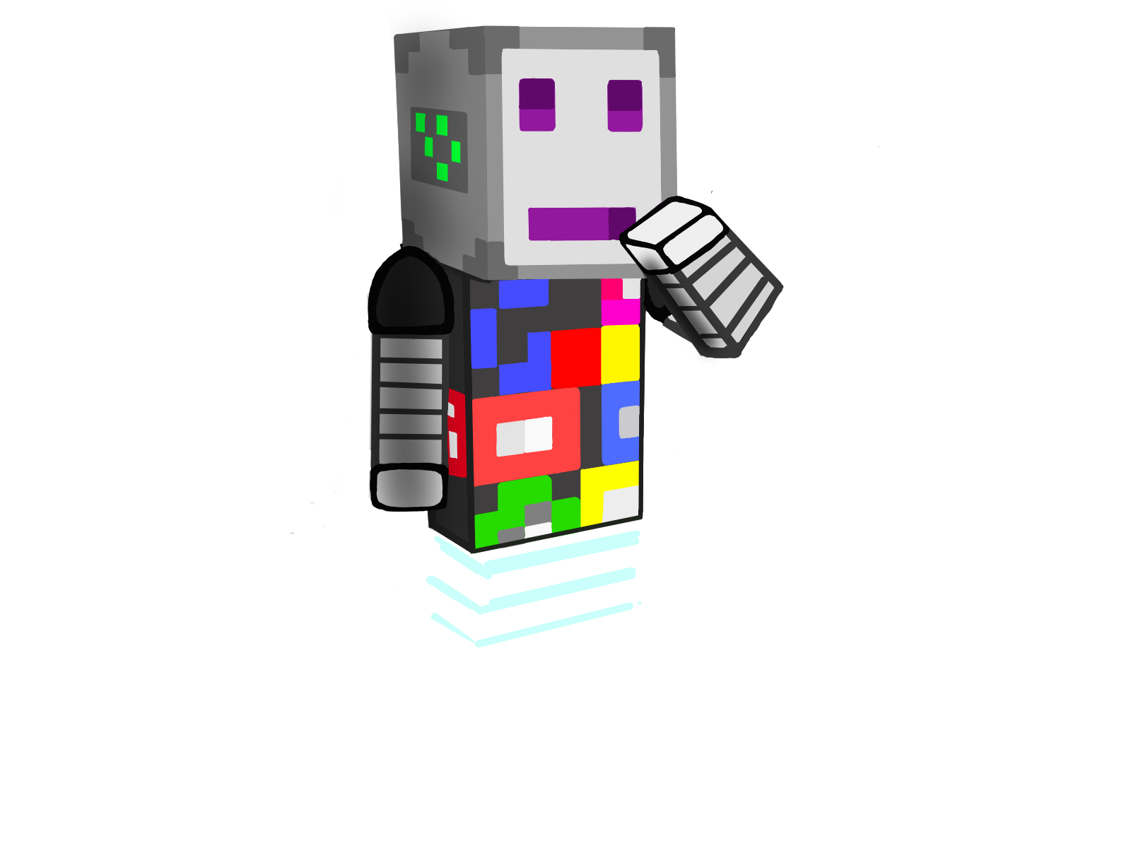
What is Social Media?
3
Name 3 good things about Social Media

Slide 5
What is Social Media?
3
Name 3 not so good things about Social Media

Slide 6
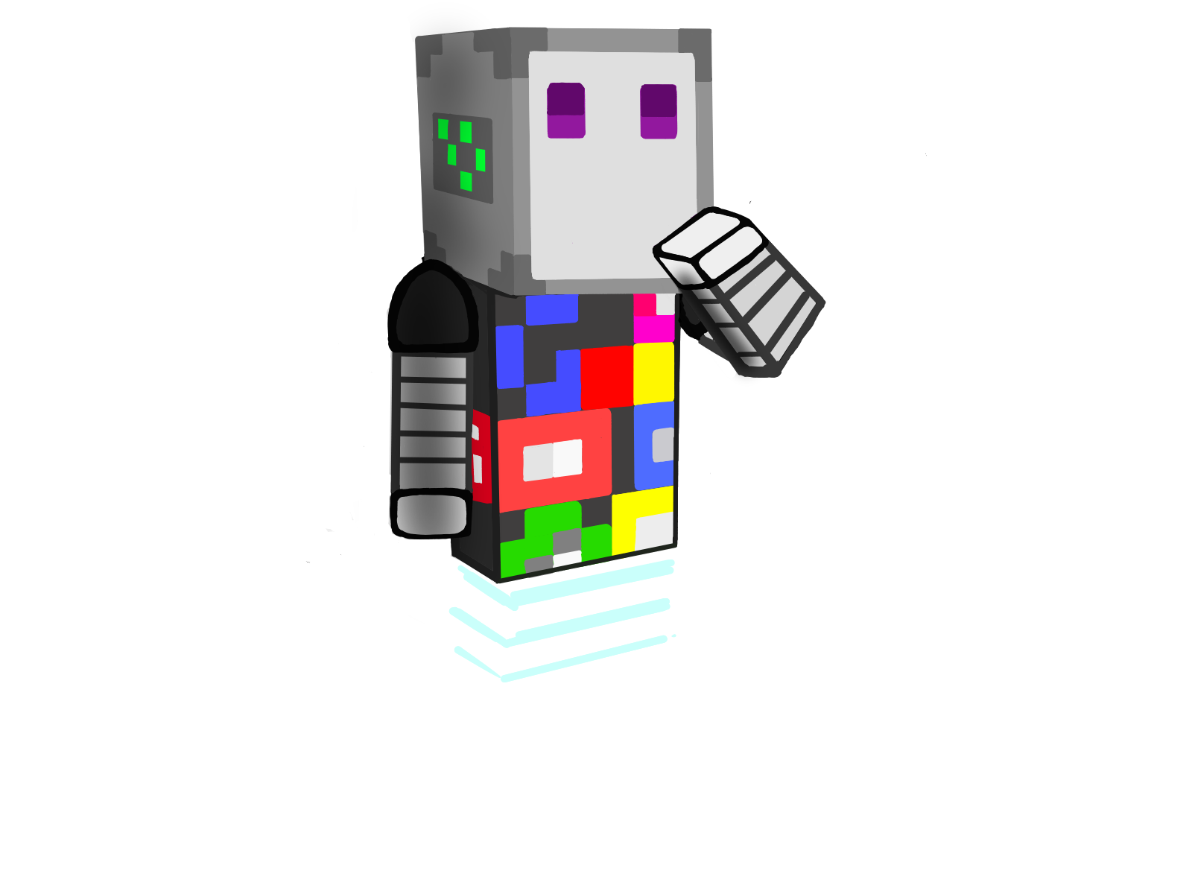
Using Social Media
Don’t “friend” with strangers!
Even if you have common friends
If you don’t know them, don’t “friend” them

Slide 7
Using Social Media
Don’t share your location, mobile number or any personal details online

Slide 8
Using Social Media
Don’t post hurtful or inappropriate messages

Slide 9
Using Social Media
Get your parents/ guardians permission before joining any new sites

Slide 10
Using Social Media
Ask a parent/ guardian to check the privacy settings

Slide 11
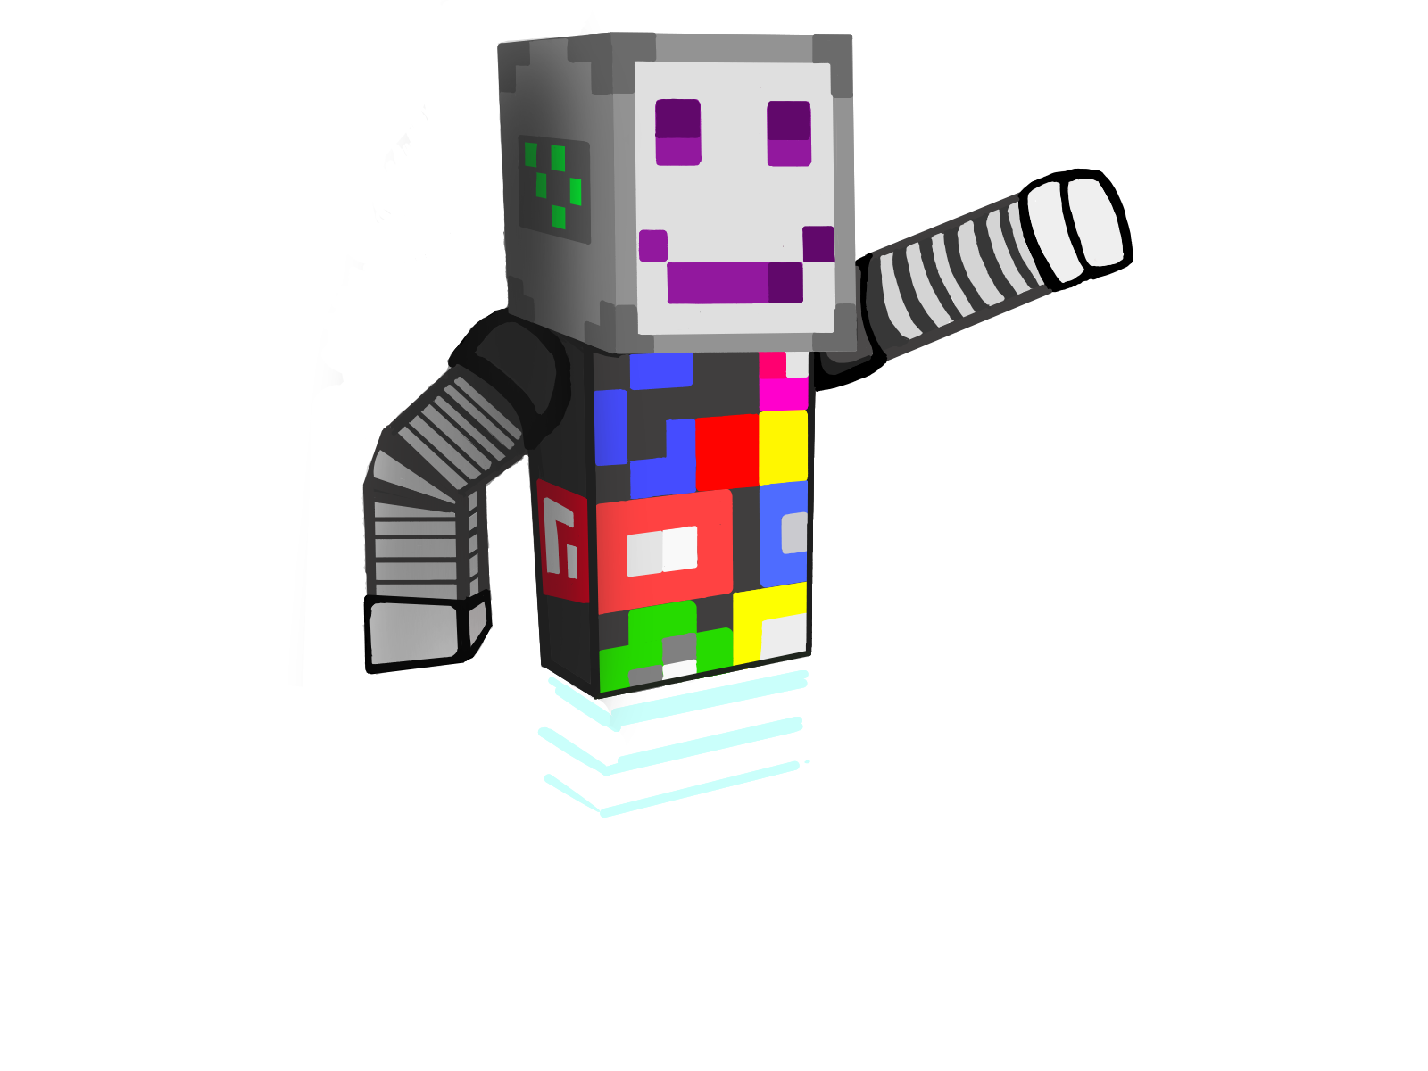
Is Alex’s profile safe?

Slide 12
Are Alex’s posts safe?

Slide 13
Are Alex’s photos safe?

Slide 14
Are Alex’s settings safe?

Slide 15
Using Social Media Safely
Hey, Alex, have you ever heard of social media?
Emily
Alex
Yeah, it’s like those websites where you can post pictures and stuff, right?
Exactly! You can share things with your friends and see what they're up to. But my mom says we have to be careful when using it.

Slide 16
Using Social Media Safely
She says there are good things and bad things about it.
You can connect with friends and family who live far away, and you can learn about different places and stuff.
You also have to be careful about the things you share.
Why’s that?
Emily
Alex
What do you mean?

Slide 17
Using Social Media Safely
Mom told me not to share personal information with people I don't know. There are some people who might pretend to be nice, but they might not be nice at all
Emily
Alex
Oh, I get it. Like, they might not be who they say they are.
Yeah, exactly! Just yesterday, I got a friend request from someone I don't know. I didn't accept it

Slide 18
Using Social Media Safely
Really? What did you do?
Emily
Alex
I told my mom about it, and she said I did the right thing. It's important to only connect with people we know and trust in real life.
That's smart. So, what did you do with the friend request?

Slide 19
Using Social Media Safely
I ignored it and didn't accept it. Better to be safe than sorry!
Emily
Alex
Yeah, we should always be careful and make sure we're being safe online.
Totally! We can always talk to our parents or teachers if we have any doubts or questions

Slide 20
Using Social Media Safely
Social Media Safety Poster
Create a poster about safety tips for using social media.
Present your ideas
What are the key messages you want to share?
Clipart: https://clipart-library.com/

Slide 21
All clipart-images from https://clipart-library.com
https://clipart-library.com/clipart/125403.htm. 9.10.2023
https://clipart-library.com/clipart/hacker-cliparts-15.htm 9.10.2023
https://clipart-library.com/clip-art/detective-silhouette-19.htm9.10.2023
https://clipart-library.com/clip-art/51-514564_this-free-icons-png-design-of-consulting-detecti ve.htm 9.10.2023
https://clipart-library.com/clipart/296270.htm 9.10.2023
https://clipart-library.com/clipart/caesar-salad-cliparts-11.htm 9.10.2023
https://clipart-library.com/clip-art/symbols-transparent-background-12.htm 9.10.2023
https://clipart-library.com/clipart/false-cliparts-19.htm 9.10.2023
https://clipart-library.com/clipart/opinion-cliparts-25.htm 9.10.2023
https://clipart-library.com/clipart/n145213.htm 9.10.2023
https://clipart-library.com/clipart/colorful-chair-cliparts-12.htm 9.10.2023
https://clipart-library.com/clipart/BTarnoogc.htm 9.10.2023
https://clipart-library.com/clipart/282630.htm 9.10.2023
https://clipart-library.com/clipart/advertising-cliparts-3.htm
https://clipart-library.com/clipart/497558.htm 9.10.2023
https://clipart-library.com/clipart/497609.htm 9.10.2023
https://clipart-library.com/clip-art/newspaper-transparent-8.htm 9.10.2023
https://clipart-library.com/clipart/computer-safety-cliparts-16.htm 9.10.2023
https://clipart-library.com/clip-art/books-transparent-background-11.htm 9.10.2023
https://clipart-library.com/clip-art/boombox-silhouette-23.htm 9.10.2023
https://clipart-library.com/clipart/612107.htm 9.10.2023
https://clipart-library.com/clipart/612160.htm 9.10.2023
https://clipart-library.com/clipart/437734.htm 9.10.2023
https://clipart-library.com/clip-art/789015_social-networking-png.htm 9.10.2023
https://clipart-library.com/clip-art/facebook-like-transparent-background-2.htm 9.10.2023
https://clipart-library.com/clipart/cartoon-dolphin-clipart-3.htm 9.10.2023

Slide 22
https://clipart-library.com/clipart/sweet-elephant-cliparts-3.htm 9.10.2023
https://clipart-library.com/clipart/elephant-cliparts-2.htm 9.10.2023
https://clipart-library.com/clipart/767579.htm
https://clipart-library.com/clipart/free-cliparts-marker-24.htm
https://clipart-library.com/clipart/pencil-clipart_7.htm 9.10.2023
https://clipart-library.com/clipart/617563.htm 9.10.2023
https://clipart-library.com/clipart/graphic-design-clipart-12.htm 9.10.2023
https://clipart-library.com/clipart/8iG6GoEjT.htm 9.10.2023
https://clipart-library.com/clipart/1918307.htm 9.10.2023
https://clipart-library.com/clipart/cliparts-locked-files-20.htm 9.10.2023
https://clipart-library.com/clipart/100212.htm 9.10.2023
https://clipart-library.com/clipart/kids-playing-outside-clipart-8.htm 9.10.2023
https://clipart-library.com/clipart/internet-cliparts_17.htm 9.10.2023
https://clipart-library.com/clipart/social-media-free-png-image.htm 9.10.2023
https://clipart-library.com/clipart/1477504.htm 9.10.2023
https://clipart-library.com/clipart/movie-reel-clipart_10.htm 9.10.2023
https://clipart-library.com/clipart/2071961.htm 9.10.2023
https://clipart-library.com/clipart/1303337.htm 9.10.2023
https://clipart-library.com/reading-magazines.html 9.10.2023
https://clipart-library.com/clipart/100615.htm 9.10.2023
https://clipart-library.com/clipart/Crocodile-Free-PNG-Image.htm 9.10.2023
https://clipart-library.com/clipart/112709.htm 9.10.2023
https://clipart-library.com/clipart/1767269.htm 9.10.2023
https://clipart-library.com/clipart/science-book-cliparts-2.htm 9.10.2023
https://clipart-library.com/clipart/725965.htm 9.10.2023
https://clipart-library.com/clipart/network-sharing-cliparts-20.htm 9.10.2023
https://clipart-library.com/clipart/fake-cliparts-25.htm 9.10.2023
https://clipart-library.com/clip-art/146-1462844_fake-news-png-transparent-svg-onlygfx-fake-news.htm 9.10.2023
https://clipart-library.com/clipart/506268.htm 9.10.2023
https://clipart-library.com/clipart/search-cliparts-1.htm 9.10.2023

