Slide 1
Lesson plan – Advertising Literacy
8-10 years
Media Literacy for All

Slide 2
Where is Advertising?
People can pay to have their message advertised so that they can share it with more people

Slide 3
Where is Advertising?
Where is Advertising?
Companies who make clothes, toys and sports kits, pay to have their message advertised
Companies who make food products pay to have their message advertised. Those who sell high sugar or high fat foods spend lots of money advertising their products

Slide 4
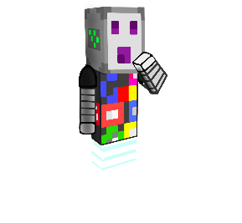
Where is Advertising?
Name three places you often see
advertising
What is your favourite type of
advertising?
1
2
3

Slide 5
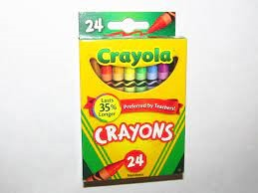
Where is Advertising?

Slide 6
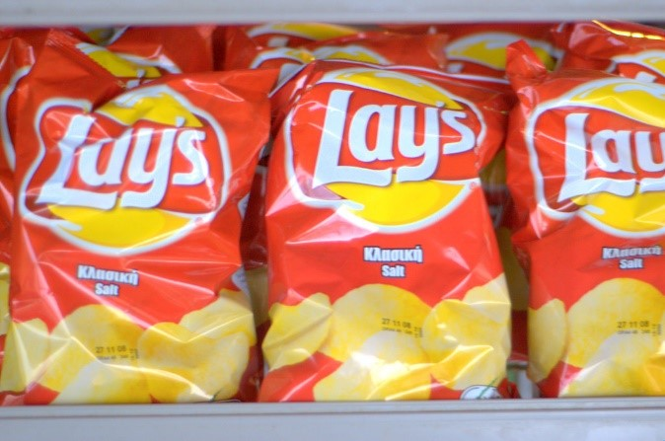
Where is Advertising?

Slide 7
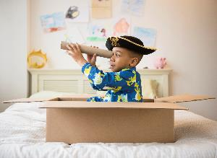
Where is Advertising?
Look around you. How many different types of advertising can you see?
Advertising is everywhere, all around us
Did you notice any brands or logos or characters?

Slide 8
Where is Advertising?
5
Pick 5 places in the classroom where you can place advertising

Slide 9
What might an ad look like?
They can be tricky to spot
There are so many advertisements everywhere that we don’t always notice all of them
They can be hidden

Slide 10
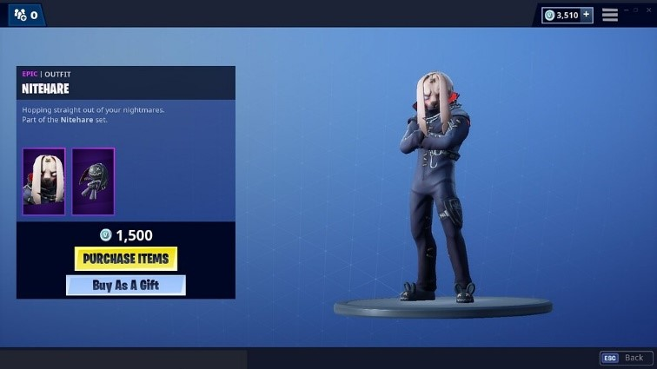
What might an ad look like?
In app purchases
Can you think of other examples?

Slide 11
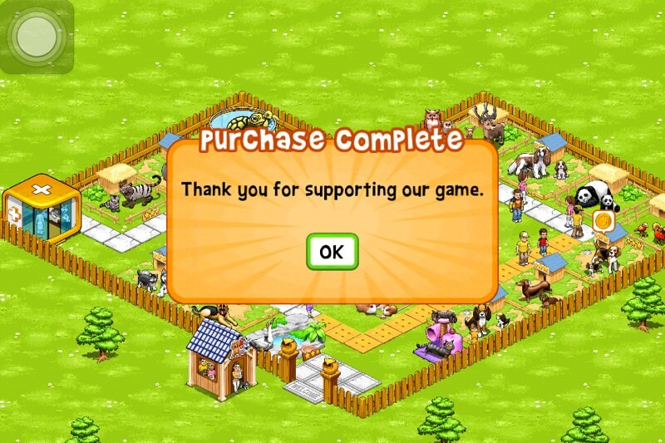
What might an ad look like?
In app purchases
Can you think of other examples?

Slide 12
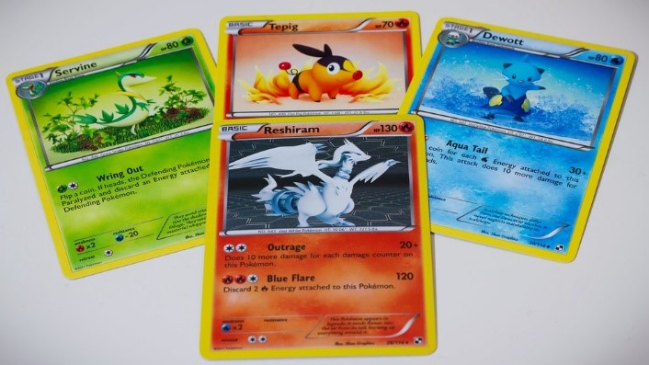
What might an ad look like?
Unboxing
Can you think of other examples?

Slide 13
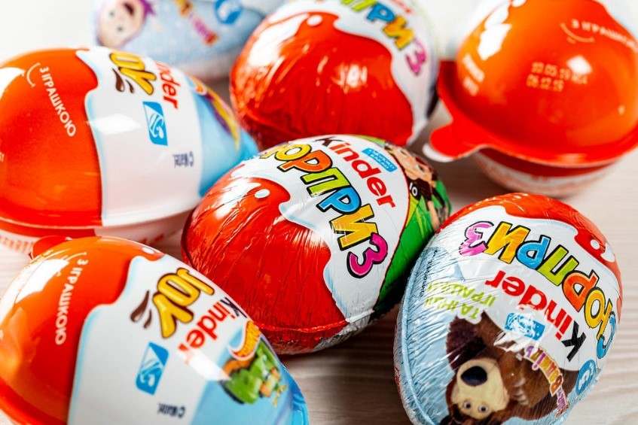
What might an ad look like?
Unboxing
Can you think of other examples?

Slide 14
Liking ads
Liking ads
Sometimes advertisements try to make you feel happy.
They hope you will begin to think the brand being advertised makes you feel happy.

Slide 15
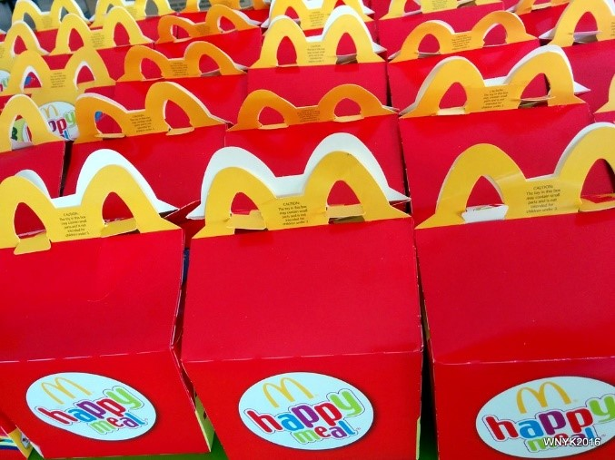
Liking ads
Happy

Slide 16
Liking ads
Liking ads
Sometimes advertisements try to make you feel happy because they hope you will begin to think the brand being advertised makes you feel happy.
Sometimes ads try to make you feel safe because they hope you will begin to think the brand being advertised makes you feel safe.

Slide 17
Liking ads
Safe

Slide 18
3
Liking ads
Name 3 ads you like
Why do you like these ads?

Slide 19
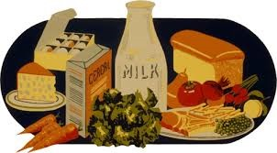
Believing ads
Sometimes advertising is used to help us to learn something new, or to remind us to do something that is good for us.

Slide 20
Believing ads
Sometimes advertising is used to help us to learn something new, or to remind us to do something that is good for us.

Slide 21
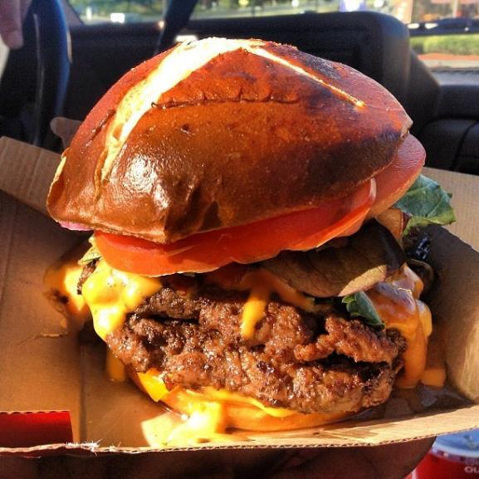
Believing ads
Do things always look as good in real life as they do in ads?

Slide 22
Believing ads
OR

Slide 23
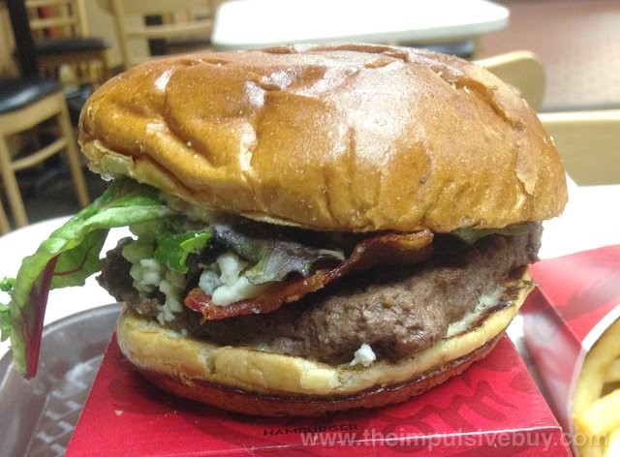
Believing ads
Do things always look as good in real life as they do in ads?

Slide 24
Believing ads
STOP
and
THINK
Is the person being paid to say the things they are saying?

Slide 25
Believing ads
STOP
and
THINK
Are they using any tricks to make me believe their message?

Slide 26
Believing ads
It is okay like an ad.
But it is very important to always make up your own mind if you believe the message or not.
Accompanying lesson plan images: Clipart: https://clipart-library.com/ Microsoft 365 stock images. Please see Teachers’ Toolkit for complete listings.

