Slide 1
Lesson plan - What is media?
8-10 years
Media Literacy for All

Slide 2
What is media?
Let's play a get up and get down game!
If you think the answer is yes GET UP
If you think it’s no, then GET DOWN!

Slide 3
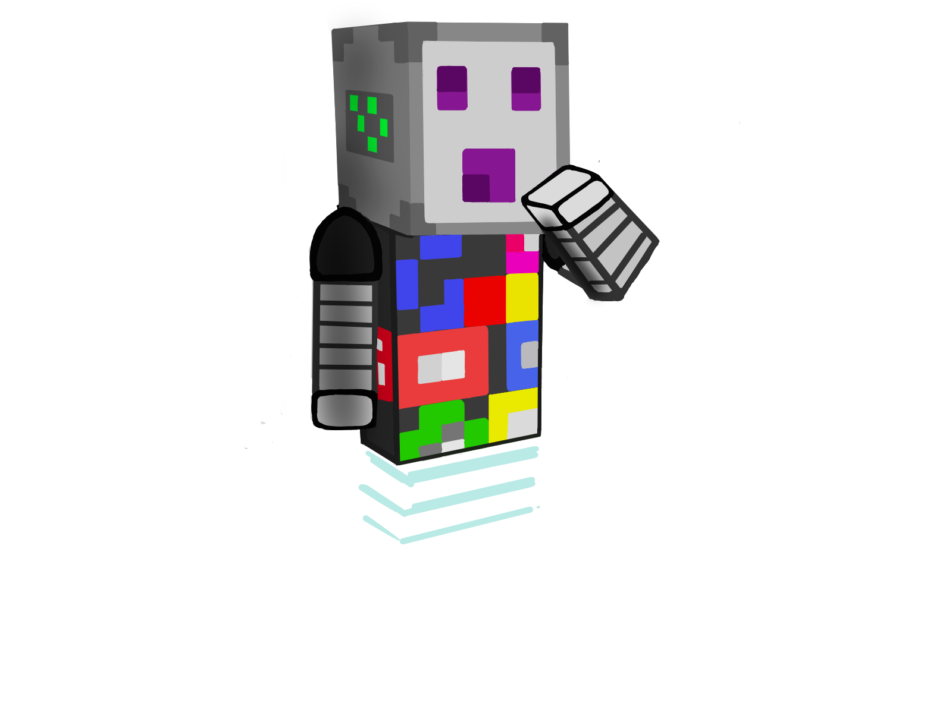
What is media?
The purpose of the media is to provide us with information.
So many forms of media!

Slide 4
Different forms of media
Do you know what media is?
Can you tell which pictures are connected to the media?
Be careful! Some of the images may not be related to media in any way!

Slide 6
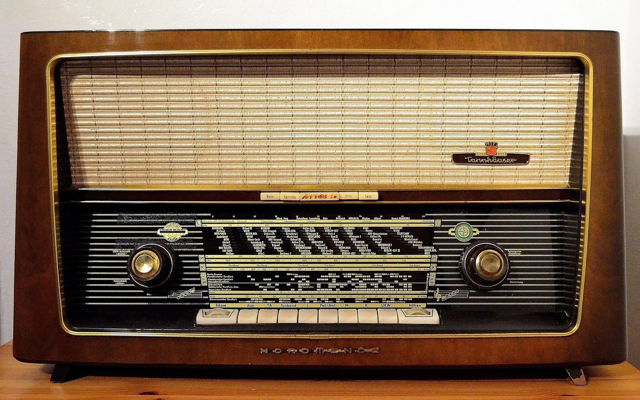

Slide 10
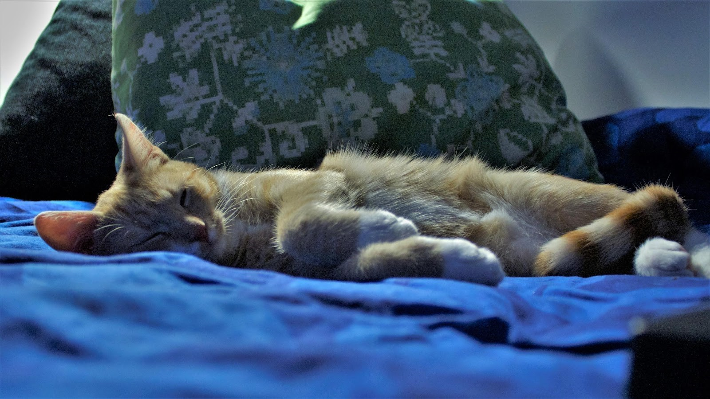

Slide 11
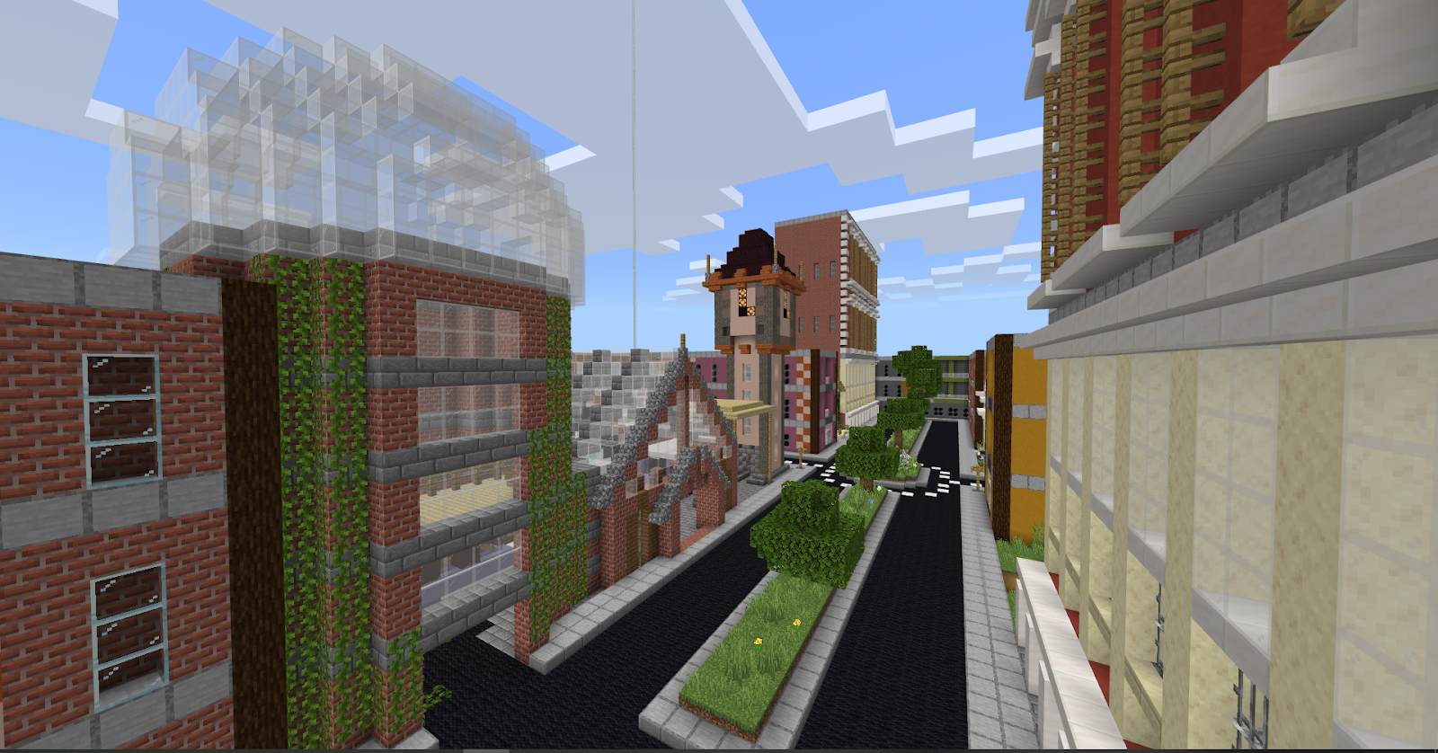

Slide 12
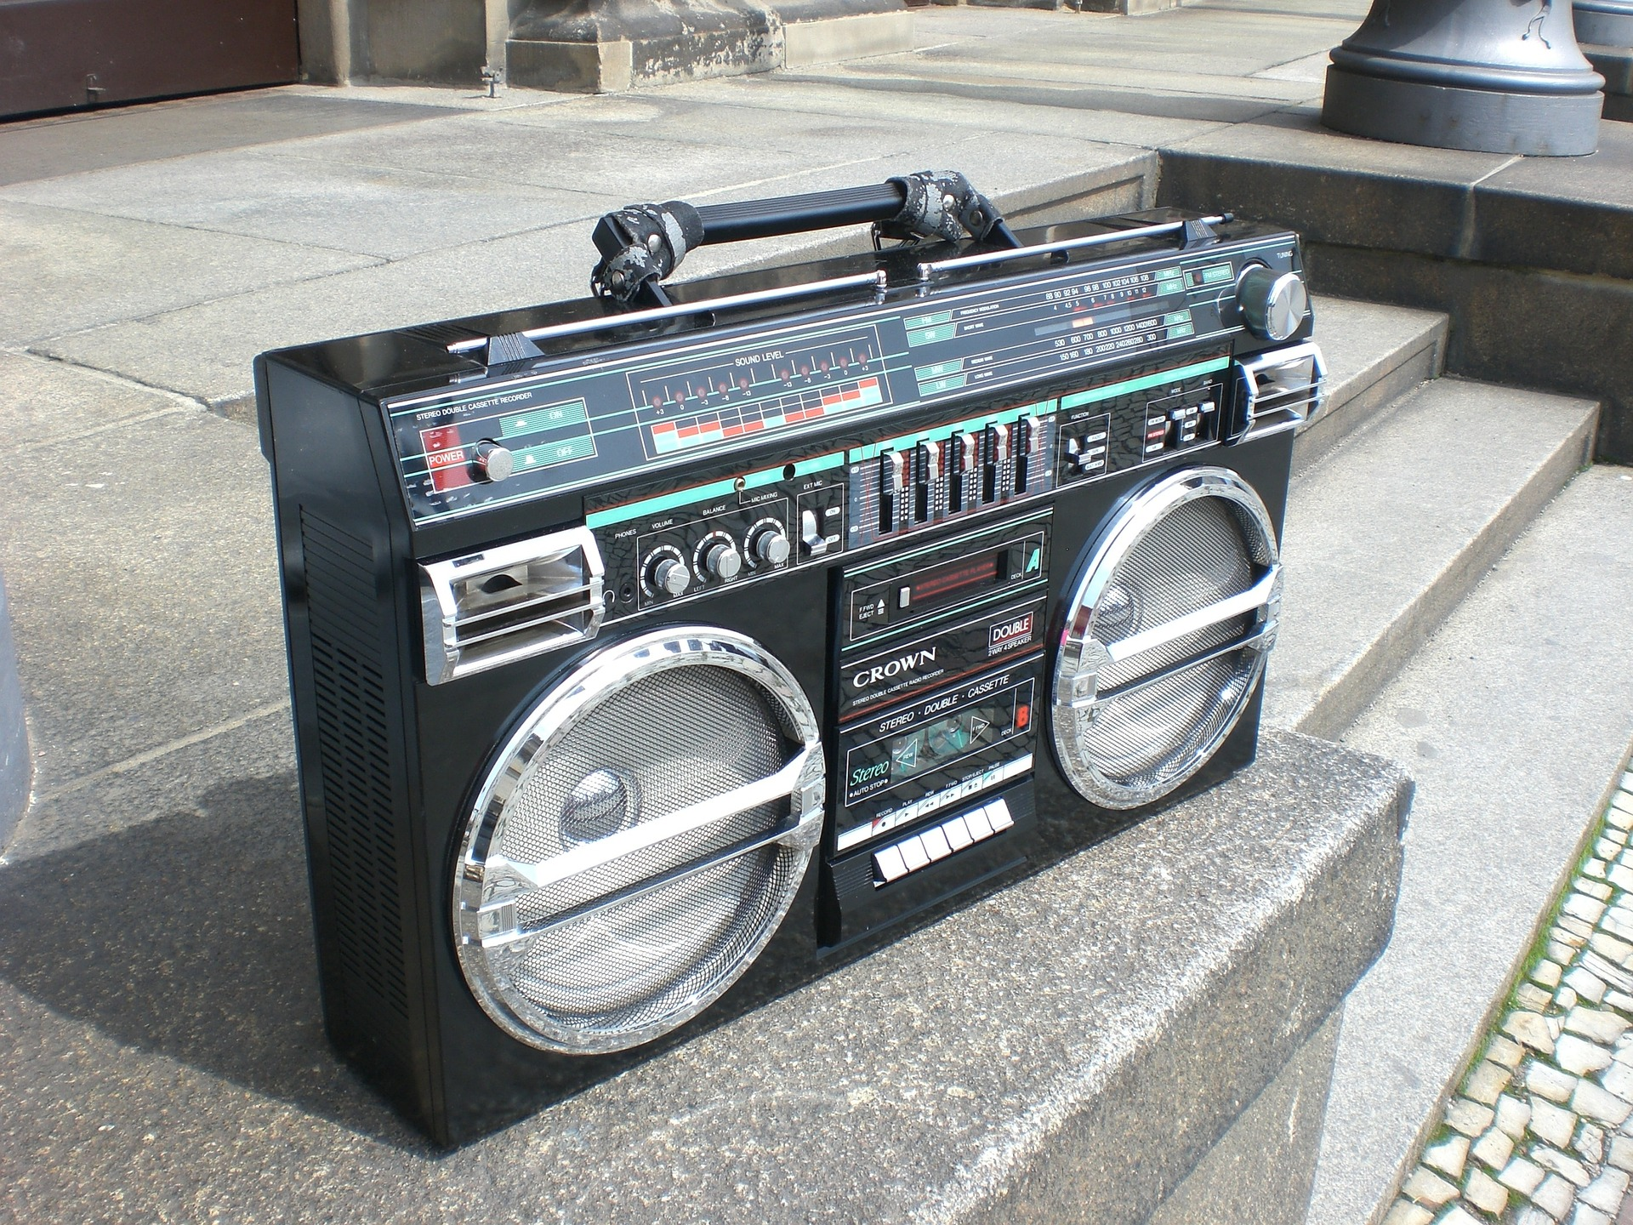
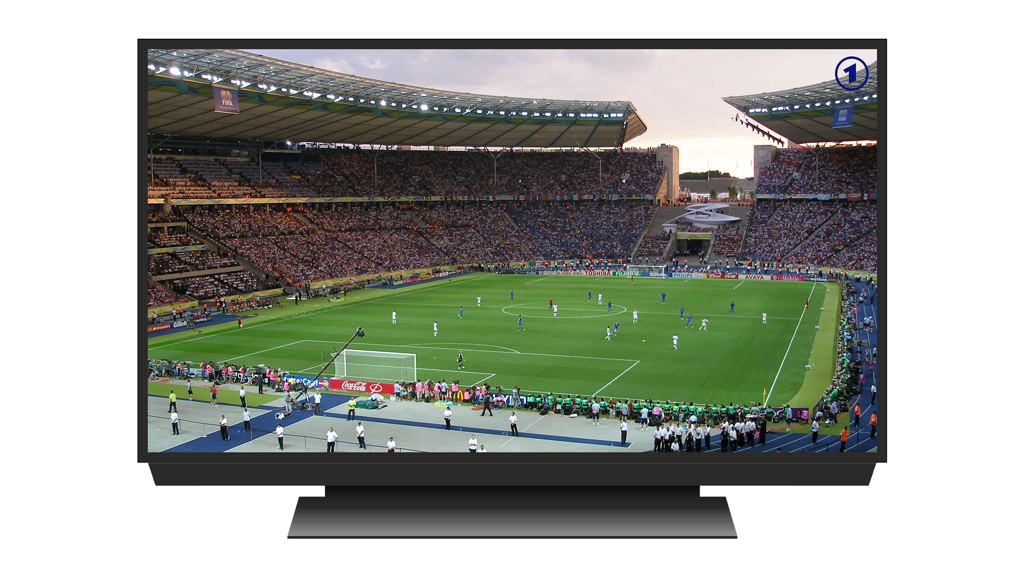
Different forms of media
Electronic Media

Slide 13
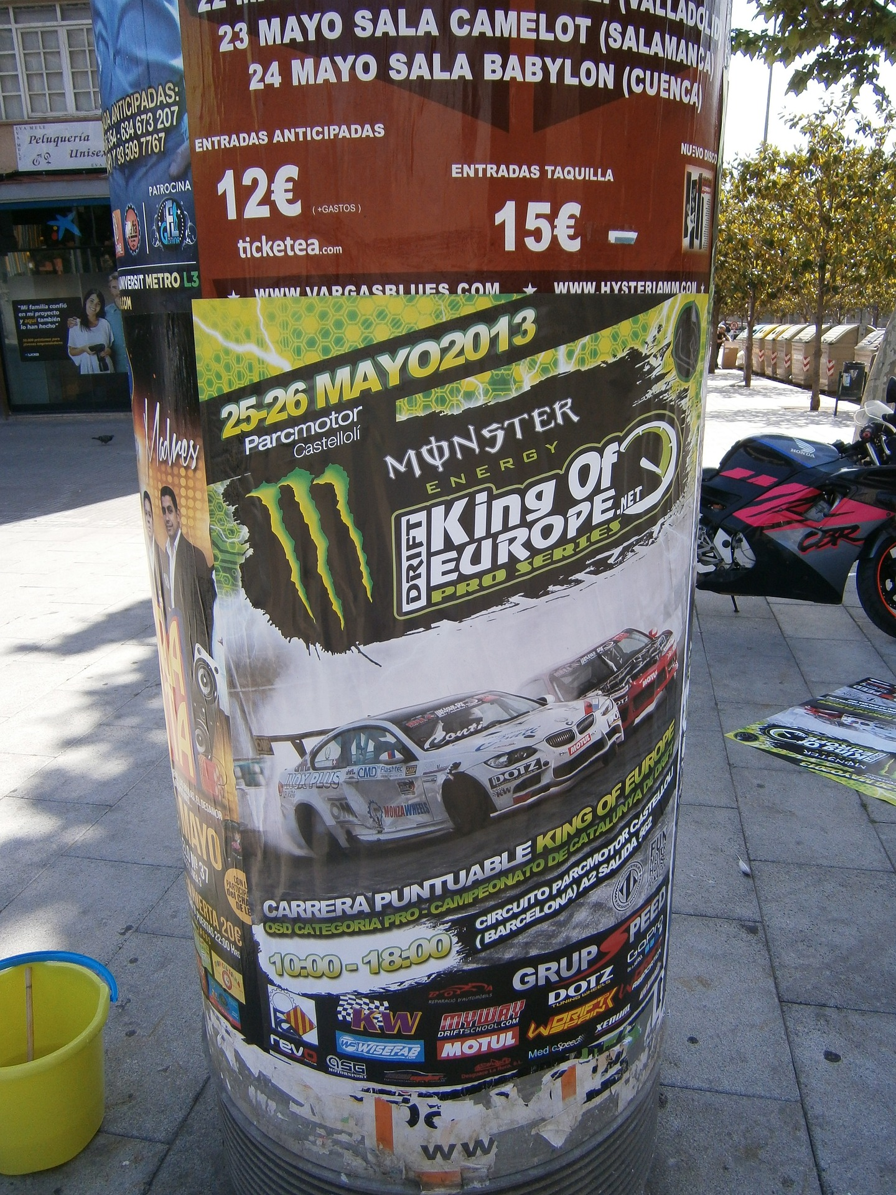
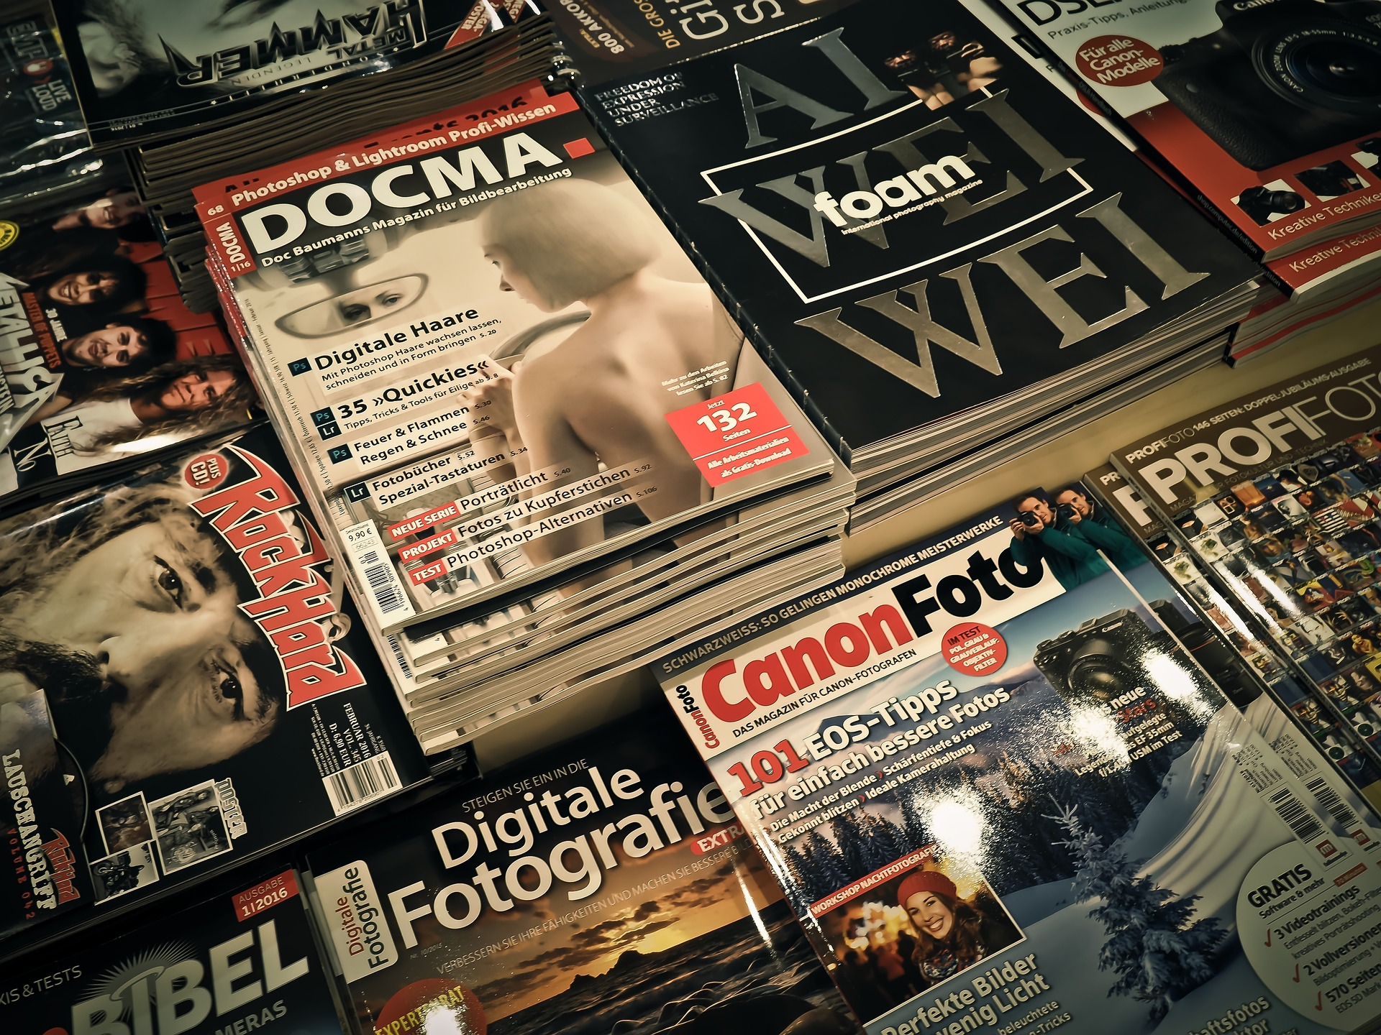
Different forms of media
Print Media

Slide 14
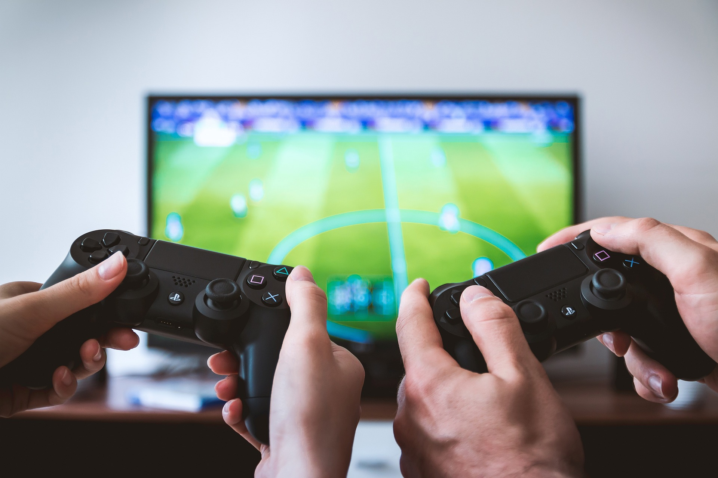
Different forms of media
Digital Media

Slide 15
Different forms of media
Social Media

Slide 16
Messages in the media
Media can:
Inform
Entertain
Advertise

Slide 17
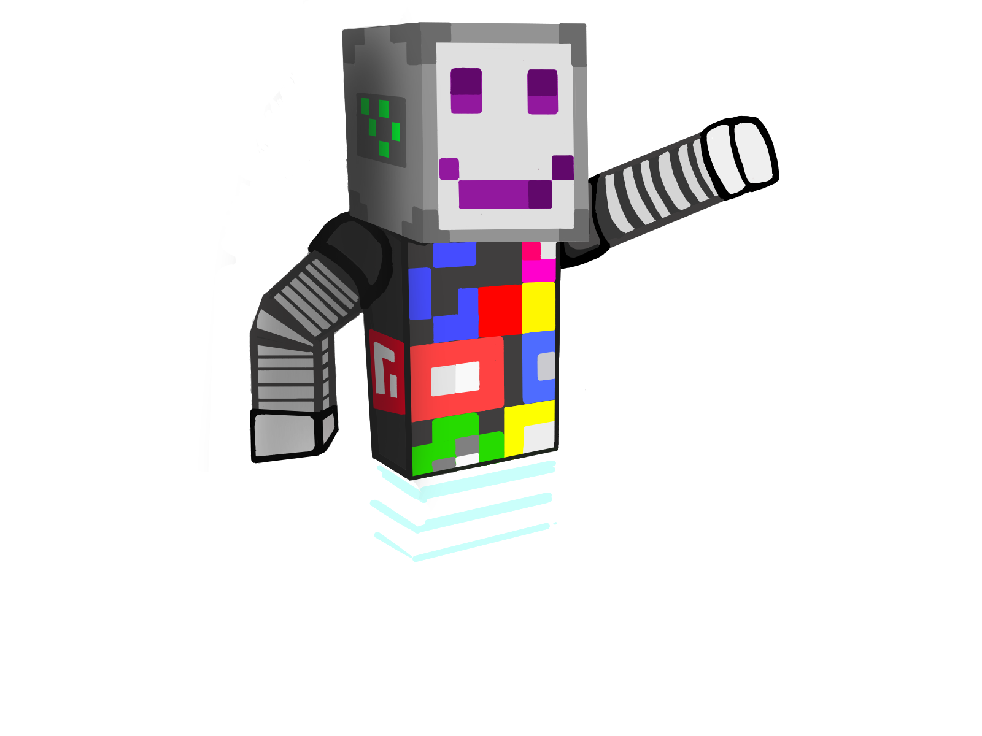
Messages in the media
Connect the forms of media with the right purpose
Psst! Commercialism means making people spend more money! Entertainment includes funny and thrilling things that we can read or watch to pass the time!
Movies
Advertisement
News
Information
Entertainment
Commercialism

Slide 18
Messages in the media
Connect the forms of media with the right purpose
Hmm… Maybe some of these can be used in more than one purpose?
Youtube-video
Book
Video game
Information
Entertainment
Commercialism

Slide 19
Messages in the media
The news tells us about recent events and shares important information.
Some forms of media can do more things than just one!
Movies, games and online videos are mostly entertainment, because in their company we want to get our thoughts out of everyday life.
Advertisements are commercial announcements that want to make us use money on something.

Slide 20
Create your own media!
Now it is your turn to make some media content of your own! Remember what you learned earlier!
Clipart: https://clipart-library.com/
Notes:
Picture list:
https://pixabay.com/fi/vectors/musta-perjantai-sosiaalisen-median-post-4606225/
https://pixabay.com/fi/photos/kirja-sivuja-avoin-kirja-lukea-1868068
https://pixabay.com/fi/photos/dollari-raha-rahoittaa-us-dollar-1426420/
https://pixabay.com/fi/photos/puhelin-n%C3%A4ytt%C3%B6-sovelluksia-292994/
https://pixabay.com/fi/photos/radio-putki-radio-radiolaite-1954856
https://pixabay.com/fi/illustrations/televisio-tv-korvat-%C3%A4%C3%A4ni-kuva-3988835/,
Johannes Repo
Minding Media Minecraft World, Microsoft Minecraft Education Edition, Microsoft,
https://pixabay.com/fi/photos/auringonlasku-ranta-siluetteja-570881/
https://pixabay.com/fi/photos/ghettoblaster-boombox-1225920/
https://pixabay.com/fi/illustrations/tv-katsella-jalkapallo-katso-tv-t%C3%A4-1271650/
https://pixabay.com/fi/photos/aikakauslehti%C3%A4-lukea-aikakauslehti-1172464/
https://pixabay.com/fi/photos/julisteet-kopioitu-julisteita-215609/
https://pixabay.com/fi/vectors/video-sapluuna-verkkosivusto-1606945/
https://pixabay.com/fi/photos/pelaamista-tv-pelaajat-pelaaja-2259191/
https://pixabay.com/fi/photos/sosiaalinen-media-facebook-763731/
Clipart:
https://clipart-library.com/

Slide 21
Picture list:
https://pixabay.com/fi/vectors/musta-perjantai-sosiaalisen-median-post-4606225/
https://pixabay.com/fi/photos/kirja-sivuja-avoin-kirja-lukea-1868068
https://pixabay.com/fi/photos/dollari-raha-rahoittaa-us-dollar-1426420/
https://pixabay.com/fi/photos/puhelin-n%C3%A4ytt%C3%B6-sovelluksia-292994/
https://pixabay.com/fi/photos/radio-putki-radio-radiolaite-1954856
https://pixabay.com/fi/illustrations/televisio-tv-korvat-%C3%A4%C3%A4ni-kuva-3988835/,
Johannes Repo
Minding Media Minecraft World, Microsoft Minecraft Education Edition, Microsoft,
https://pixabay.com/fi/photos/auringonlasku-ranta-siluetteja-570881/
https://pixabay.com/fi/photos/ghettoblaster-boombox-1225920/
https://pixabay.com/fi/illustrations/tv-katsella-jalkapallo-katso-tv-t%C3%A4-1271650/
https://pixabay.com/fi/photos/aikakauslehti%C3%A4-lukea-aikakauslehti-1172464/
https://pixabay.com/fi/photos/julisteet-kopioitu-julisteita-215609/
https://pixabay.com/fi/vectors/video-sapluuna-verkkosivusto-1606945/
https://pixabay.com/fi/photos/pelaamista-tv-pelaajat-pelaaja-2259191/
https://pixabay.com/fi/photos/sosiaalinen-media-facebook-763731/

Slide 22
All clipart-images from https://clipart-library.com
https://clipart-library.com/clipart/125403.htm. 9.10.2023
https://clipart-library.com/clipart/hacker-cliparts-15.htm 9.10.2023
https://clipart-library.com/clip-art/detective-silhouette-19.htm9.10.2023
https://clipart-library.com/clip-art/51-514564_this-free-icons-png-design-of-consulting-detecti ve.htm 9.10.2023
https://clipart-library.com/clipart/296270.htm 9.10.2023
https://clipart-library.com/clipart/caesar-salad-cliparts-11.htm 9.10.2023
https://clipart-library.com/clip-art/symbols-transparent-background-12.htm 9.10.2023
https://clipart-library.com/clipart/false-cliparts-19.htm 9.10.2023
https://clipart-library.com/clipart/opinion-cliparts-25.htm 9.10.2023
https://clipart-library.com/clipart/n145213.htm 9.10.2023
https://clipart-library.com/clipart/colorful-chair-cliparts-12.htm 9.10.2023
https://clipart-library.com/clipart/BTarnoogc.htm 9.10.2023
https://clipart-library.com/clipart/282630.htm 9.10.2023
https://clipart-library.com/clipart/advertising-cliparts-3.htm
https://clipart-library.com/clipart/497558.htm 9.10.2023
https://clipart-library.com/clipart/497609.htm 9.10.2023
https://clipart-library.com/clip-art/newspaper-transparent-8.htm 9.10.2023
https://clipart-library.com/clipart/computer-safety-cliparts-16.htm 9.10.2023
https://clipart-library.com/clip-art/books-transparent-background-11.htm 9.10.2023
https://clipart-library.com/clip-art/boombox-silhouette-23.htm 9.10.2023
https://clipart-library.com/clipart/612107.htm 9.10.2023
https://clipart-library.com/clipart/612160.htm 9.10.2023
https://clipart-library.com/clipart/437734.htm 9.10.2023
https://clipart-library.com/clip-art/789015_social-networking-png.htm 9.10.2023
https://clipart-library.com/clip-art/facebook-like-transparent-background-2.htm 9.10.2023
https://clipart-library.com/clipart/cartoon-dolphin-clipart-3.htm 9.10.2023

Slide 23
https://clipart-library.com/clipart/sweet-elephant-cliparts-3.htm 9.10.2023
https://clipart-library.com/clipart/elephant-cliparts-2.htm 9.10.2023
https://clipart-library.com/clipart/767579.htm
https://clipart-library.com/clipart/free-cliparts-marker-24.htm
https://clipart-library.com/clipart/pencil-clipart_7.htm 9.10.2023
https://clipart-library.com/clipart/617563.htm 9.10.2023
https://clipart-library.com/clipart/graphic-design-clipart-12.htm 9.10.2023
https://clipart-library.com/clipart/8iG6GoEjT.htm 9.10.2023
https://clipart-library.com/clipart/1918307.htm 9.10.2023
https://clipart-library.com/clipart/cliparts-locked-files-20.htm 9.10.2023
https://clipart-library.com/clipart/100212.htm 9.10.2023
https://clipart-library.com/clipart/kids-playing-outside-clipart-8.htm 9.10.2023
https://clipart-library.com/clipart/internet-cliparts_17.htm 9.10.2023
https://clipart-library.com/clipart/social-media-free-png-image.htm 9.10.2023
https://clipart-library.com/clipart/1477504.htm 9.10.2023
https://clipart-library.com/clipart/movie-reel-clipart_10.htm 9.10.2023
https://clipart-library.com/clipart/2071961.htm 9.10.2023
https://clipart-library.com/clipart/1303337.htm 9.10.2023
https://clipart-library.com/reading-magazines.html 9.10.2023
https://clipart-library.com/clipart/100615.htm 9.10.2023
https://clipart-library.com/clipart/Crocodile-Free-PNG-Image.htm 9.10.2023
https://clipart-library.com/clipart/112709.htm 9.10.2023
https://clipart-library.com/clipart/1767269.htm 9.10.2023
https://clipart-library.com/clipart/science-book-cliparts-2.htm 9.10.2023
https://clipart-library.com/clipart/725965.htm 9.10.2023
https://clipart-library.com/clipart/network-sharing-cliparts-20.htm 9.10.2023
https://clipart-library.com/clipart/fake-cliparts-25.htm 9.10.2023
https://clipart-library.com/clip-art/146-1462844_fake-news-png-transparent-svg-onlygfx-fake-news.htm 9.10.2023
https://clipart-library.com/clipart/506268.htm 9.10.2023
https://clipart-library.com/clipart/search-cliparts-1.htm 9.10.2023

